Slide 1
2004 Cross-shelf
28/11/2019

Slide 2
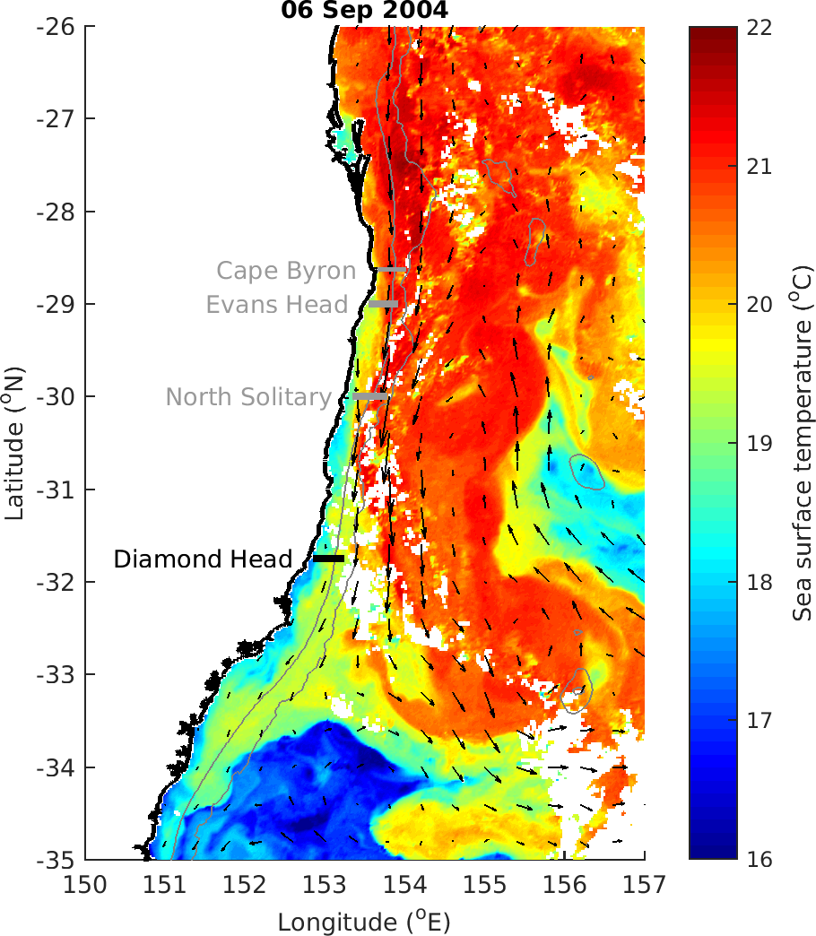

Slide 3
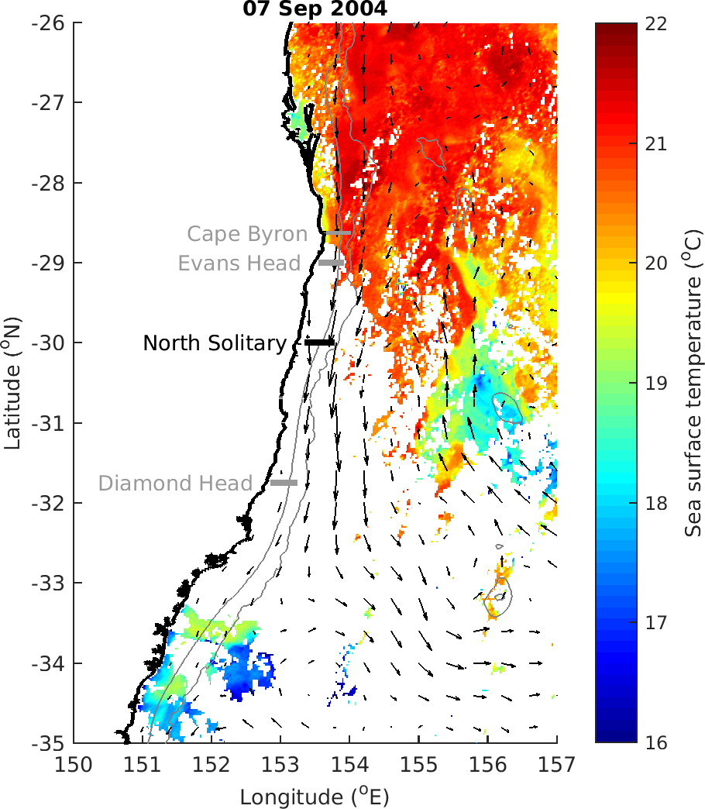

Slide 4
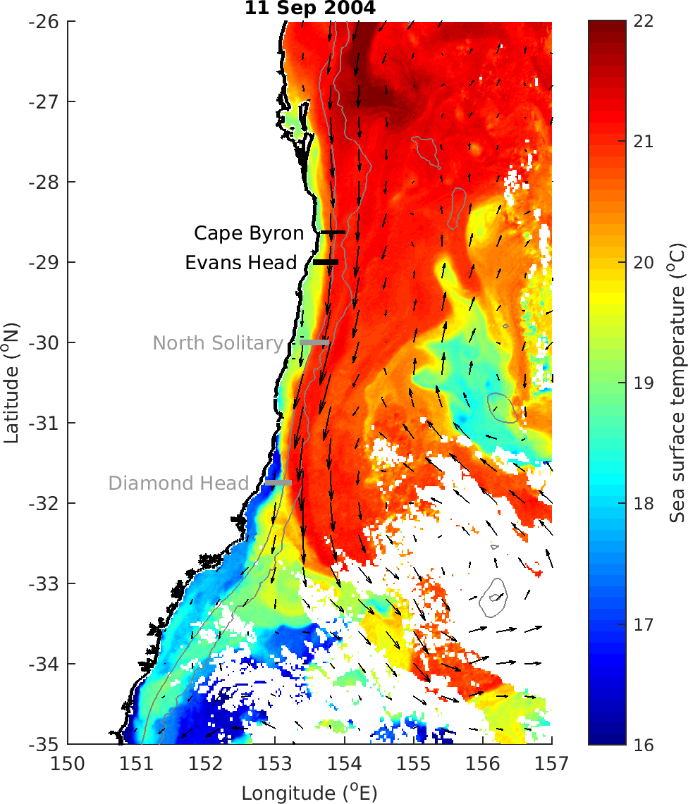

Slide 5
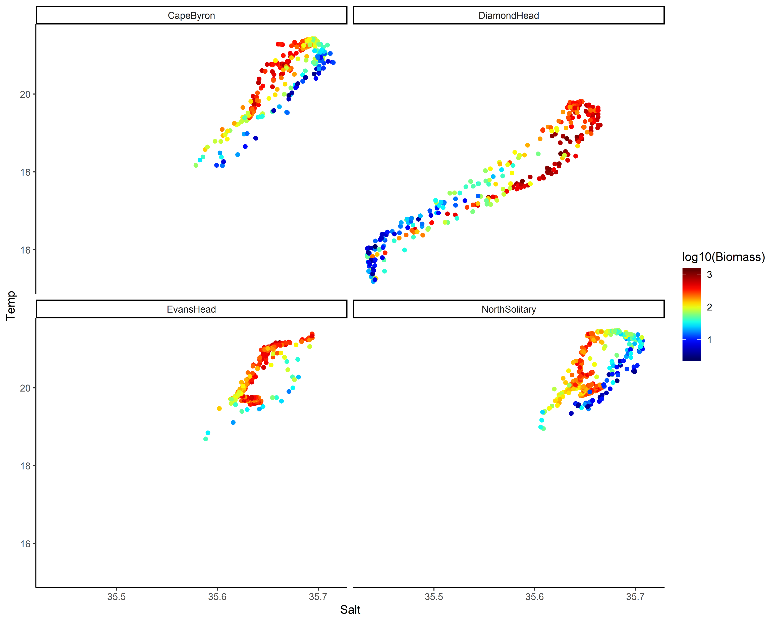
TS Plot by log₁₀(Biomass)

Slide 6
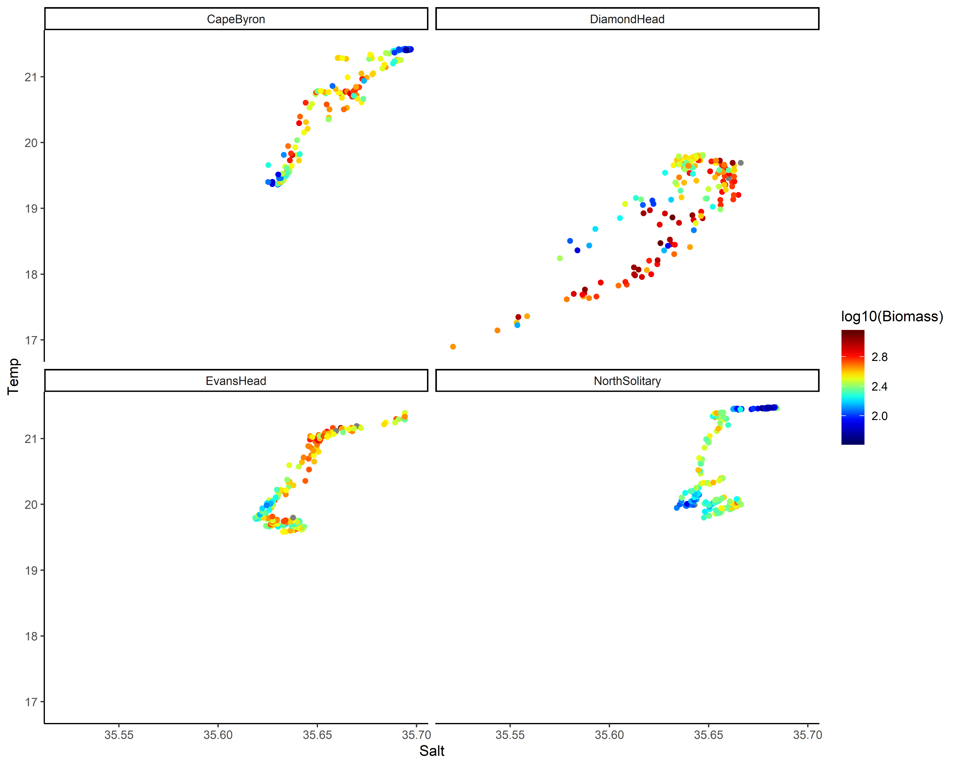
TS Plot by log₁₀(Biomass) top 50m

Slide 7
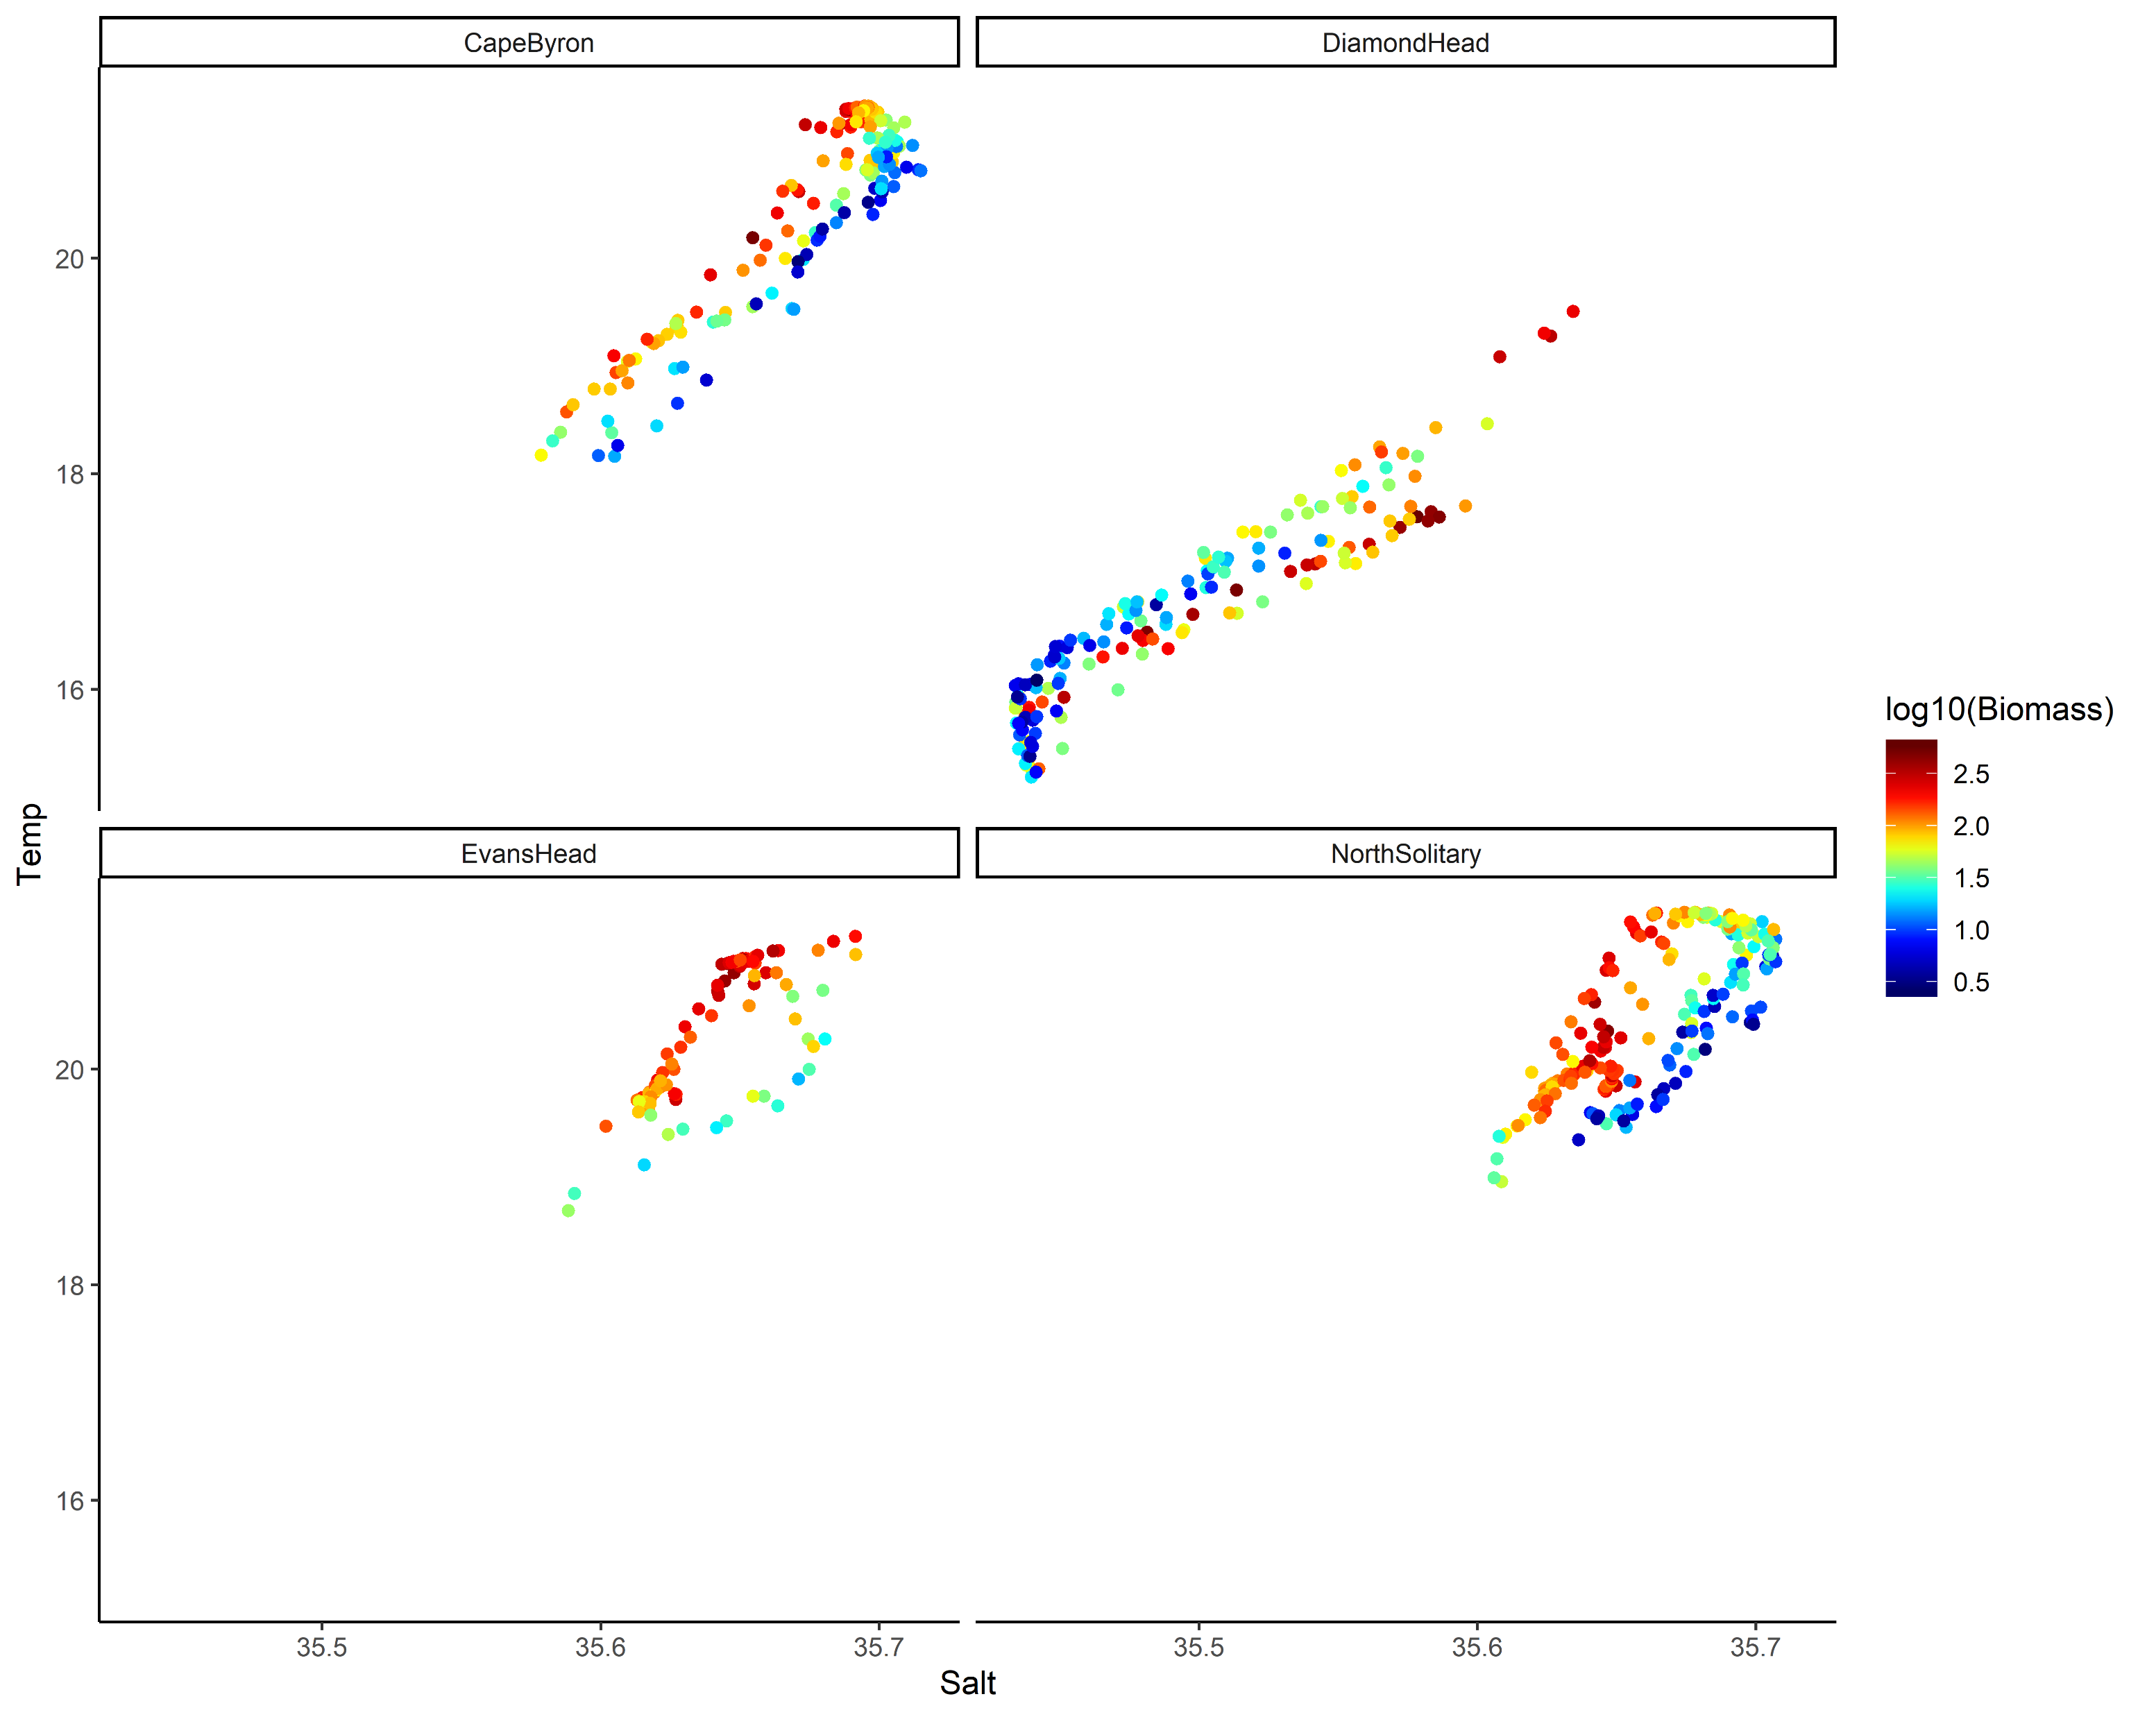
TS Plot by log₁₀(Biomass) below 50m

Slide 8
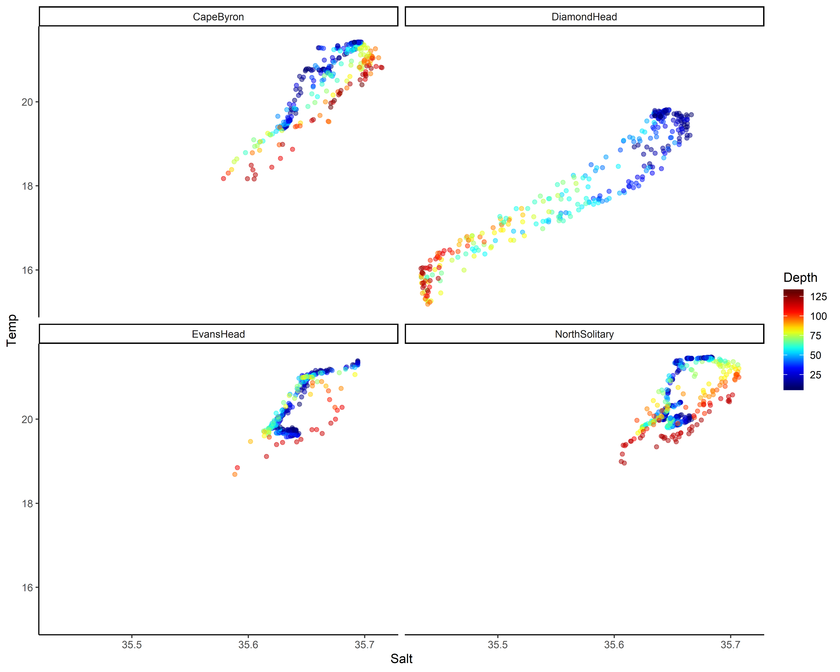
TS plot by Depth

Slide 9
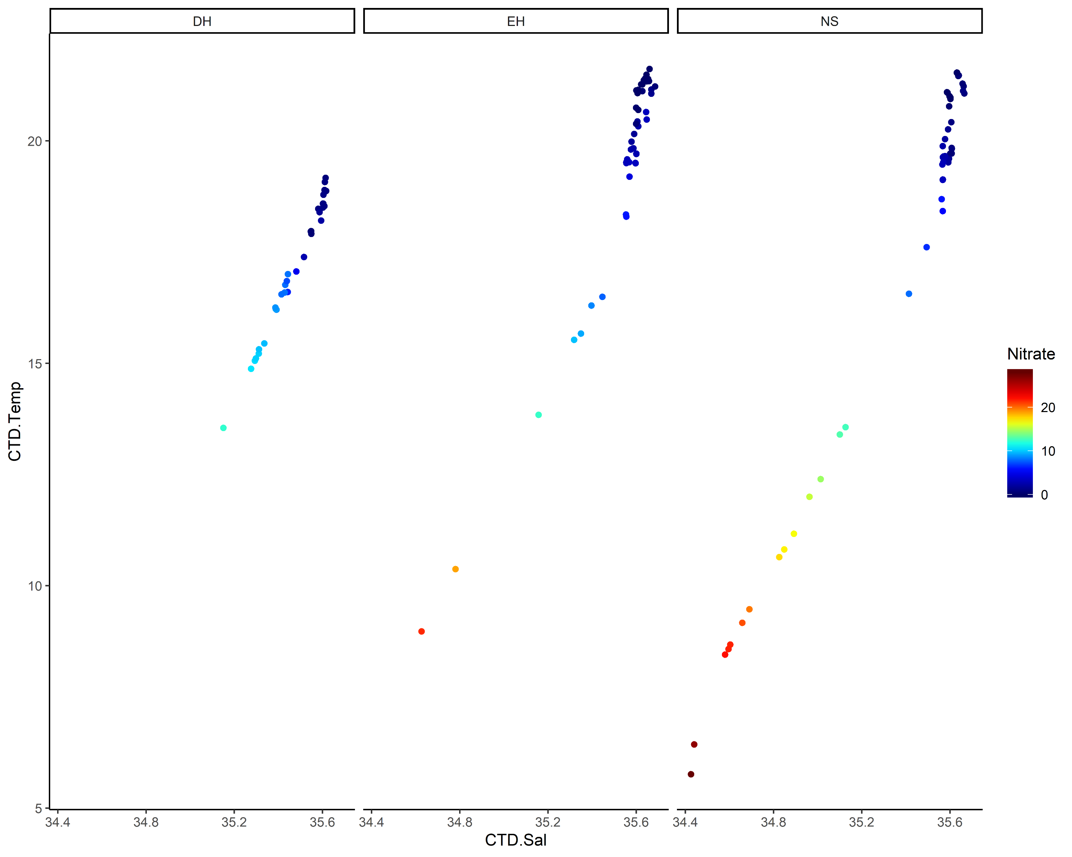
TS plot by Nitrate

Slide 10
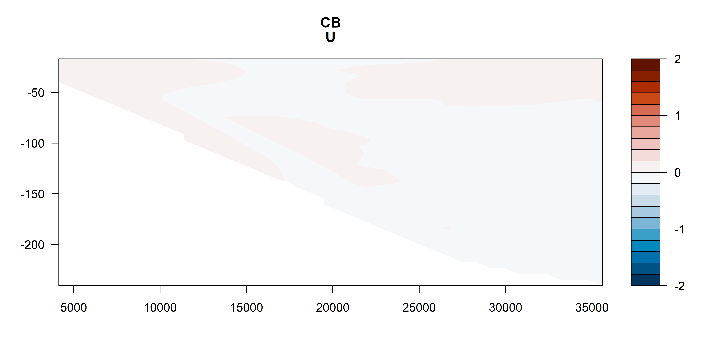
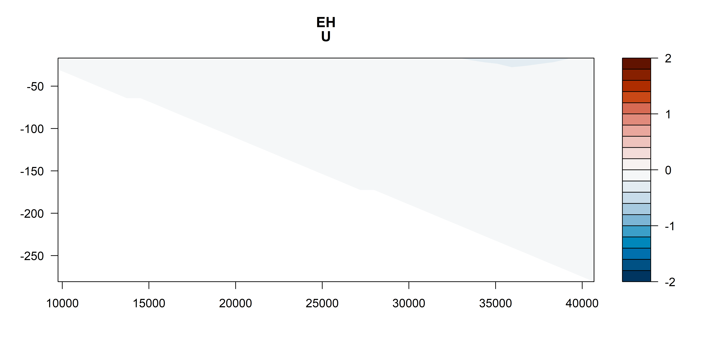
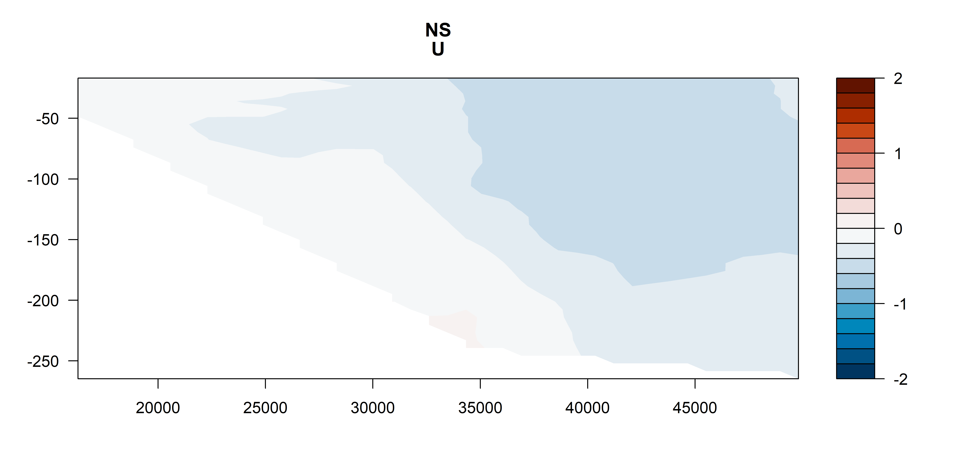
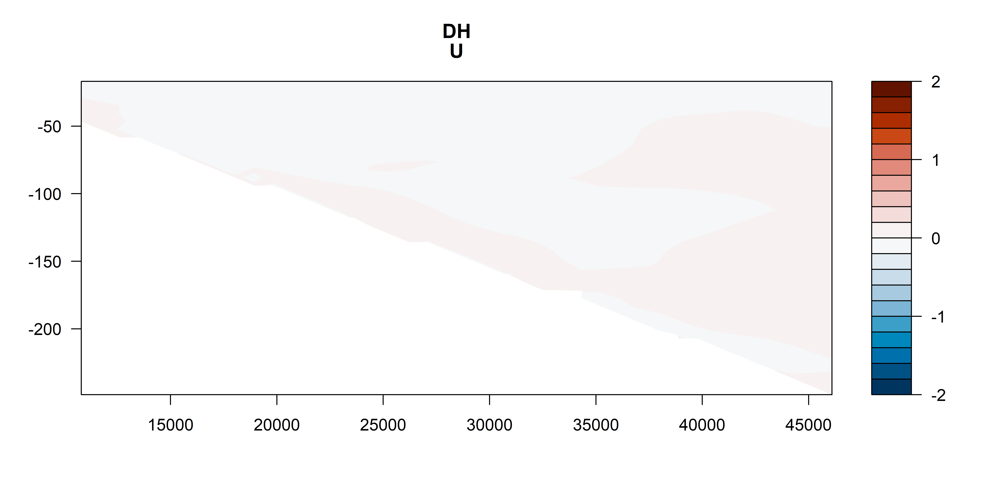
U vectors
m s⁻¹
m s⁻¹
m s⁻¹
m s⁻¹

Slide 11
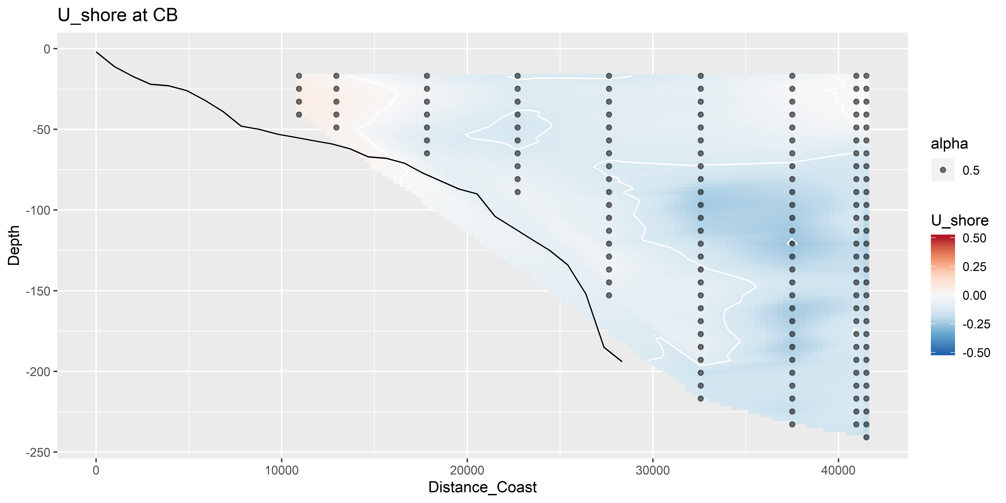
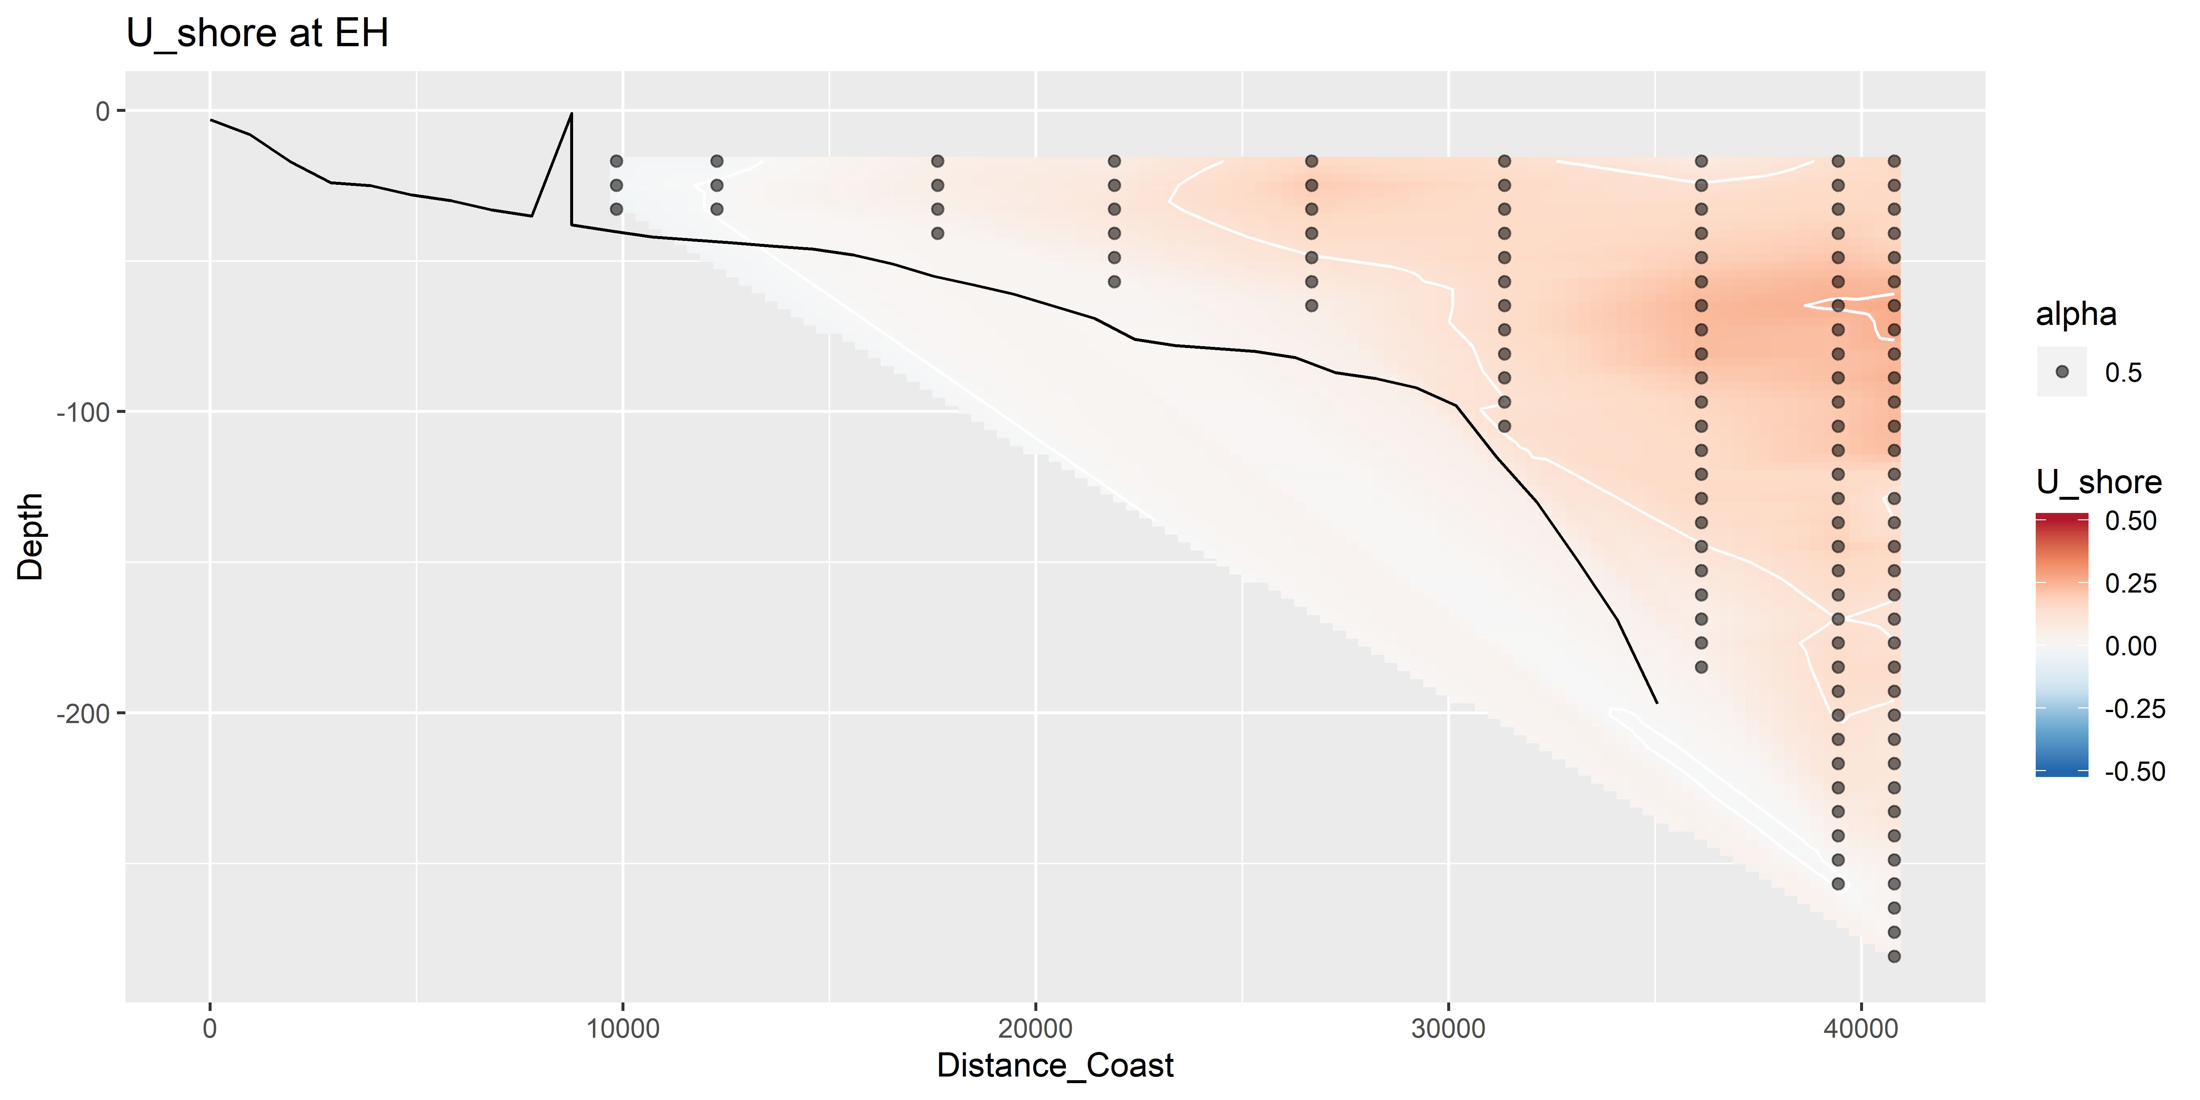
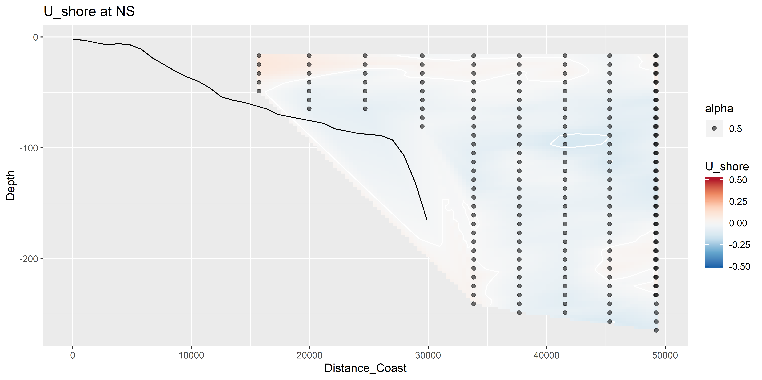
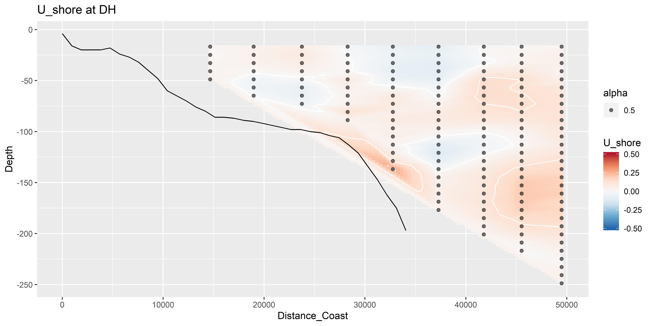
U vectors – shoreline rotated (m s⁻¹)

Slide 12
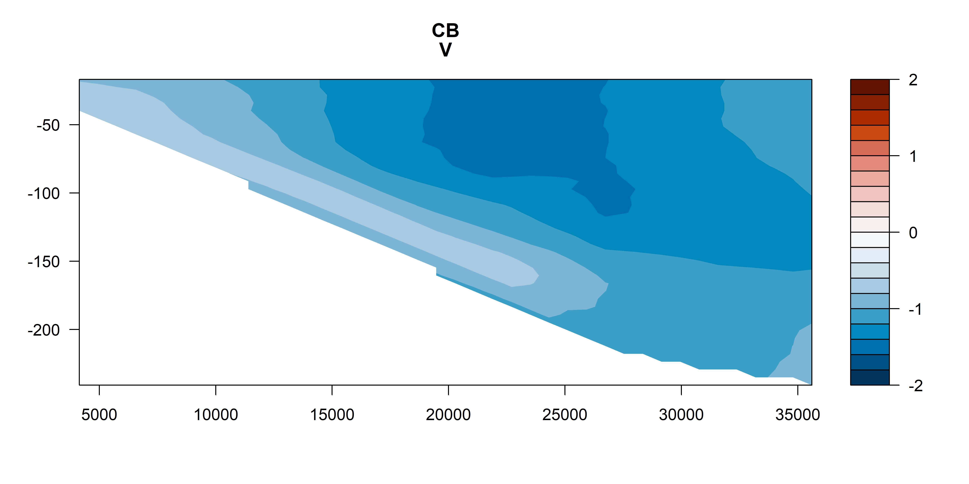
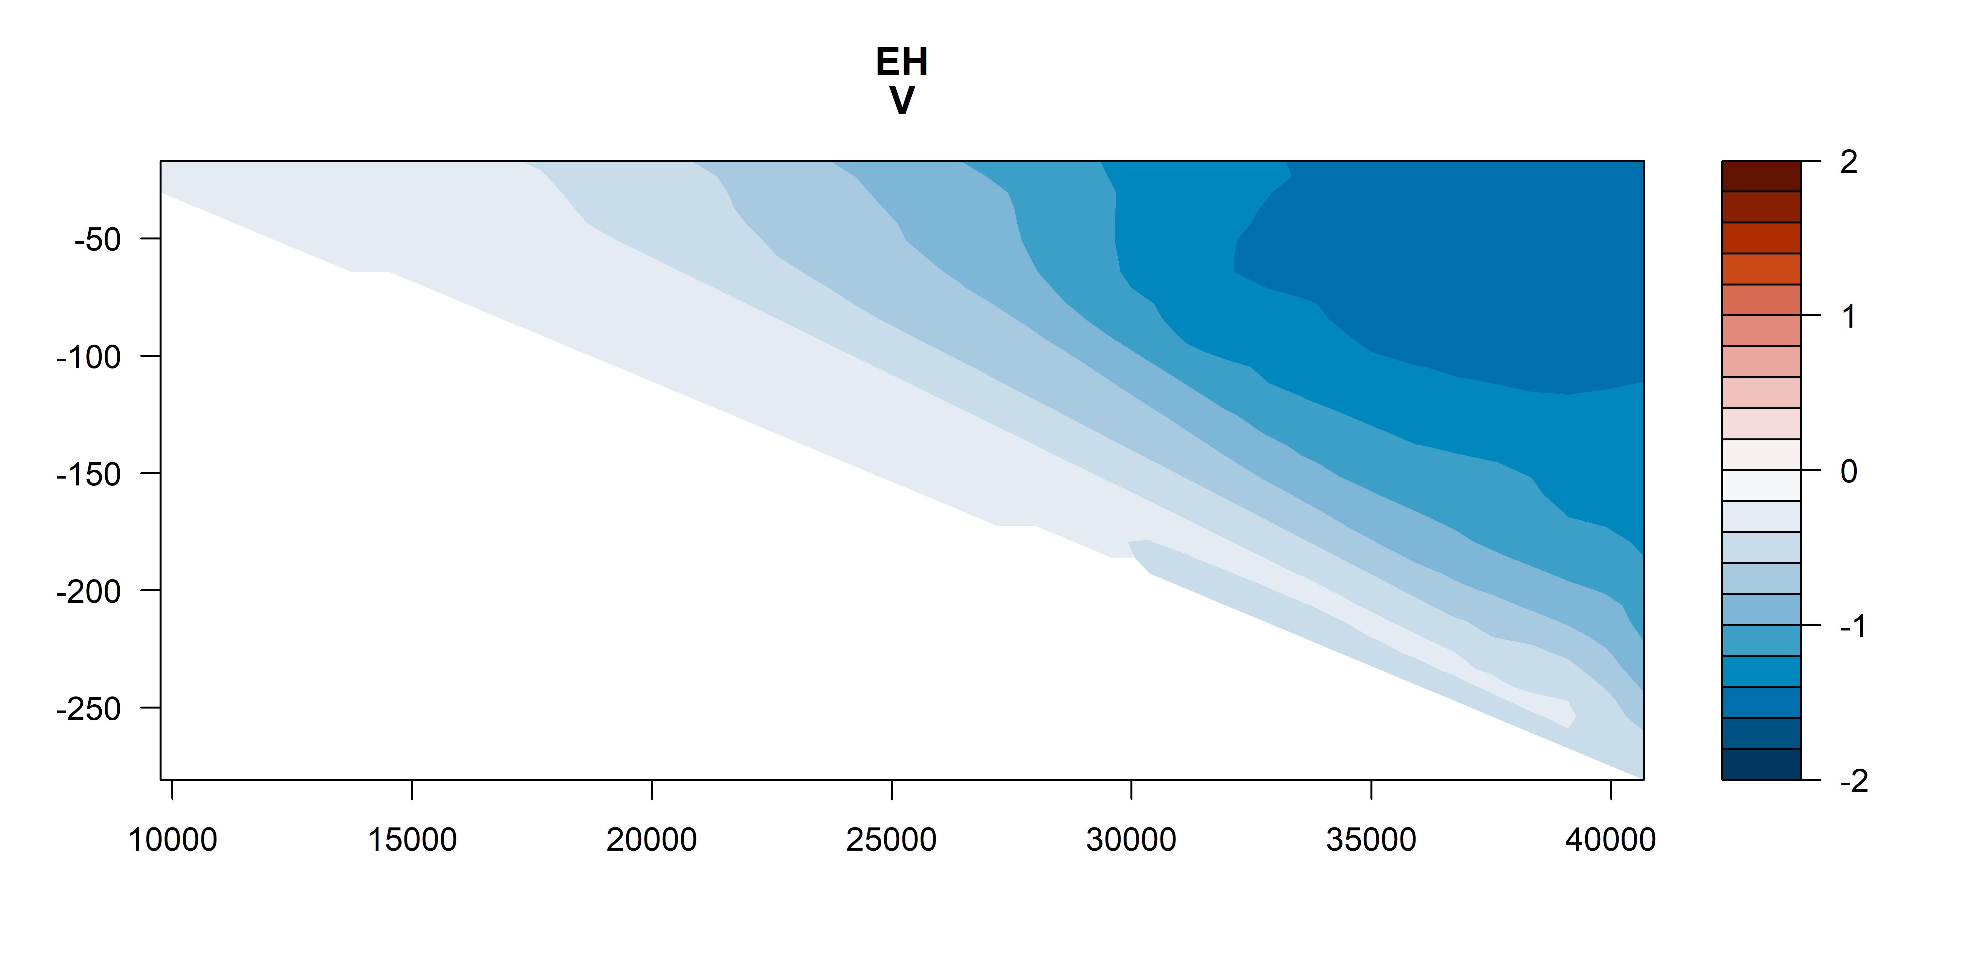
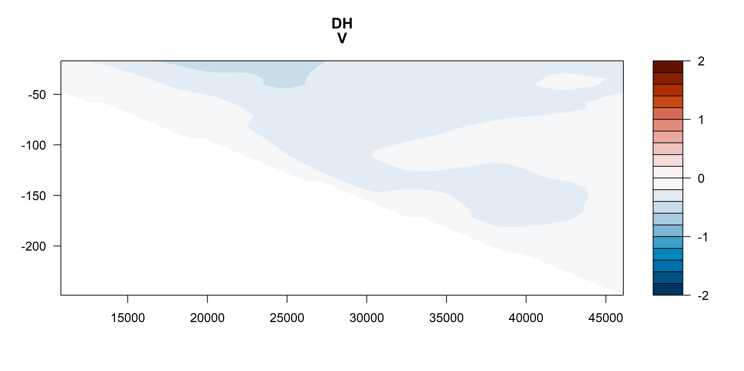
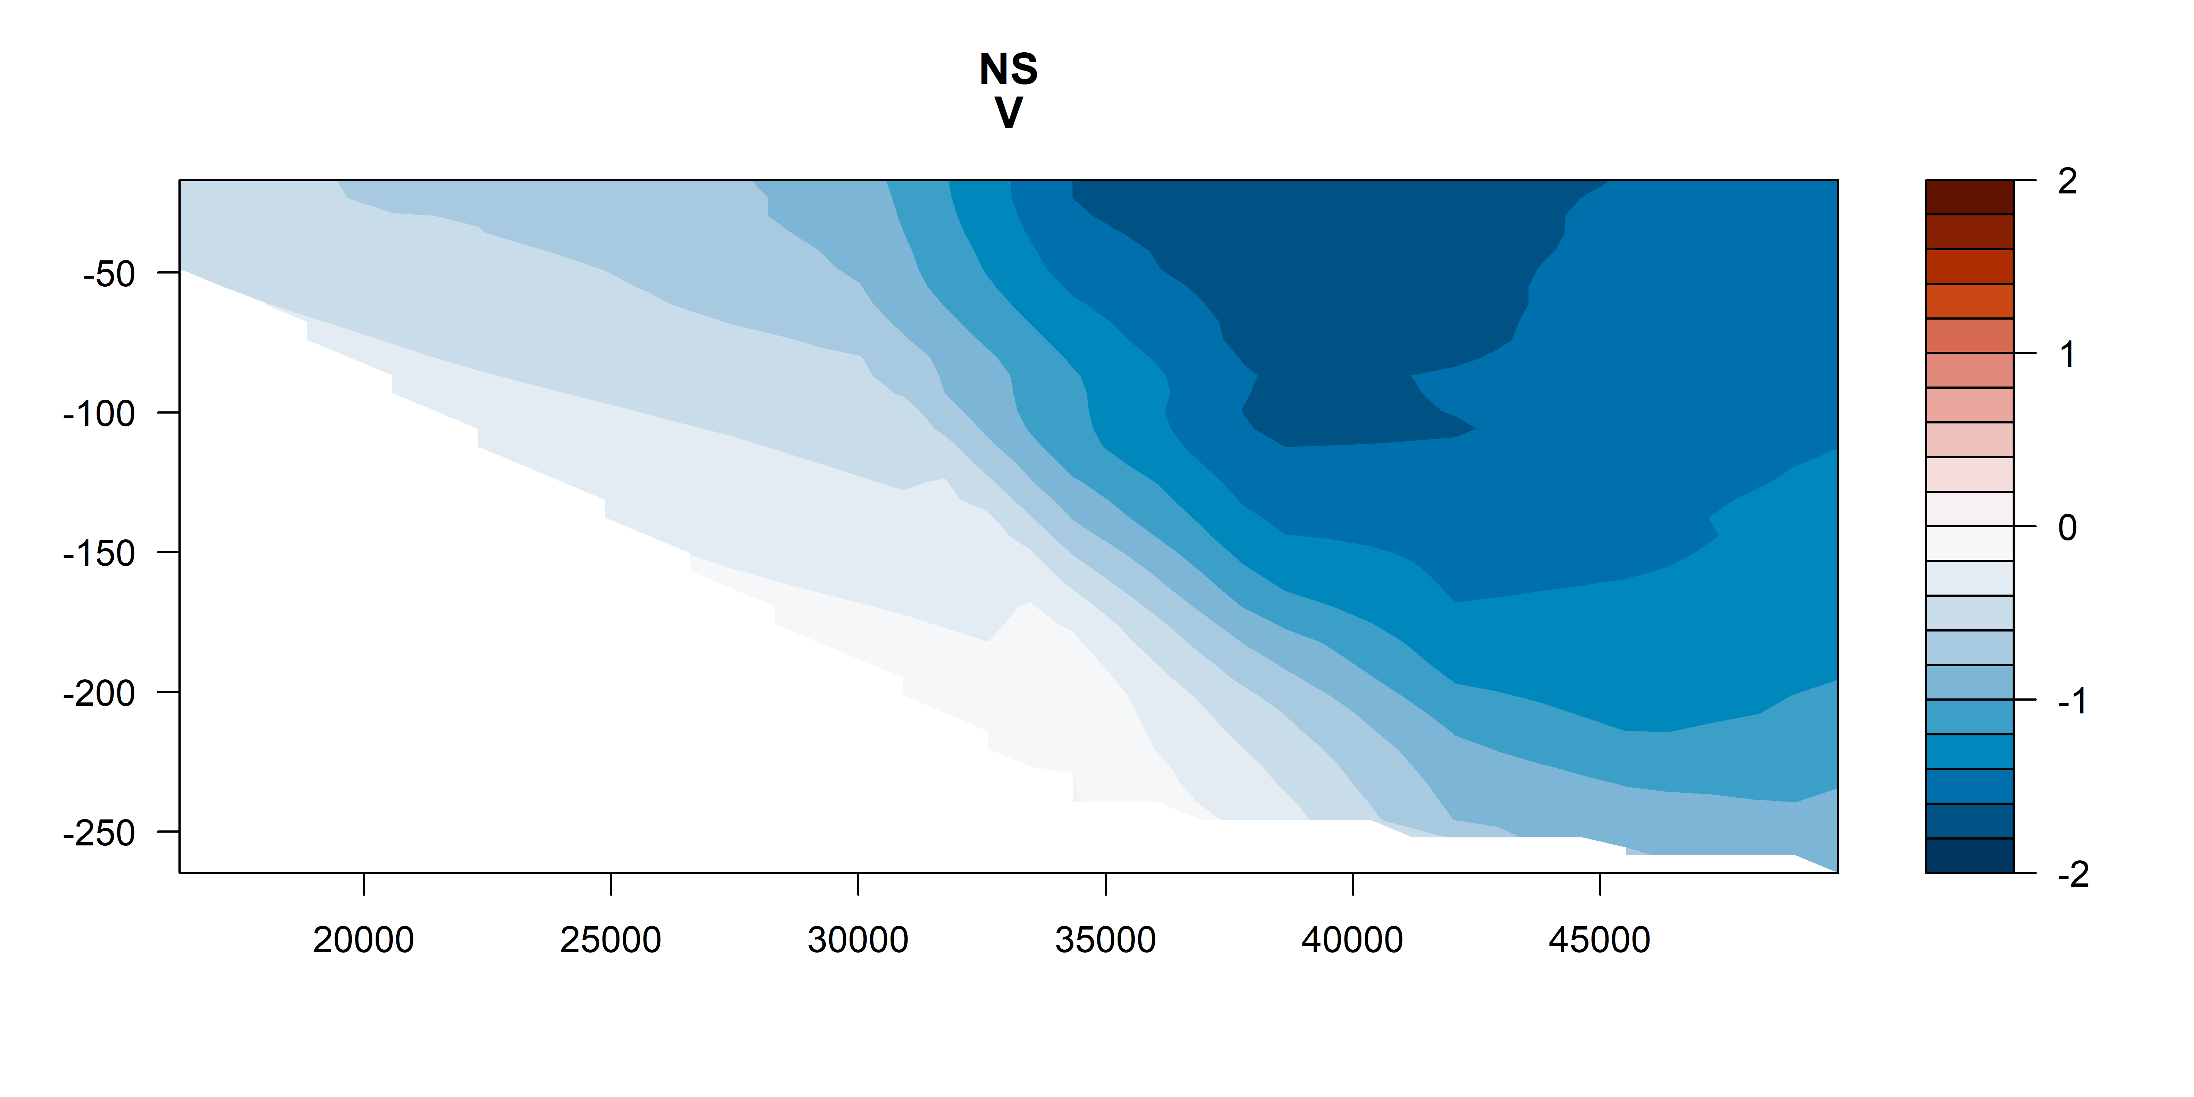
V vectors
m s⁻¹
m s⁻¹
m s⁻¹
m s⁻¹

Slide 13
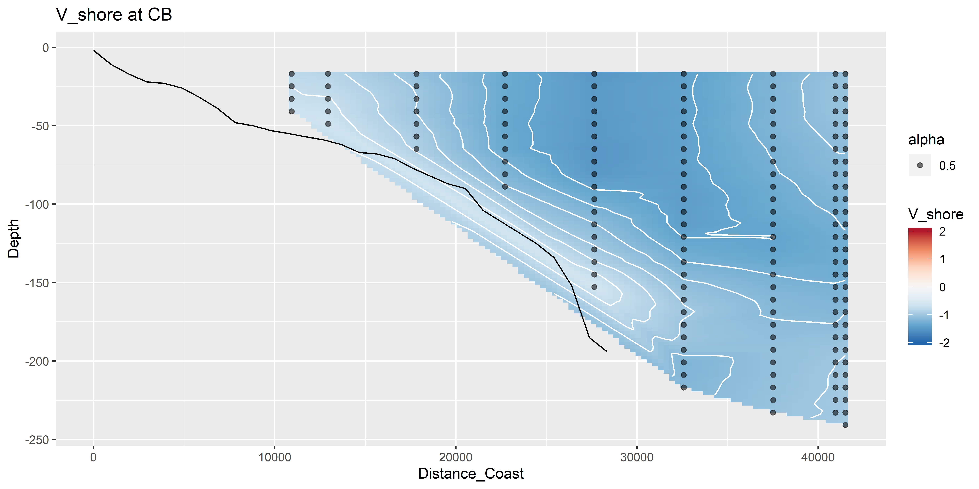
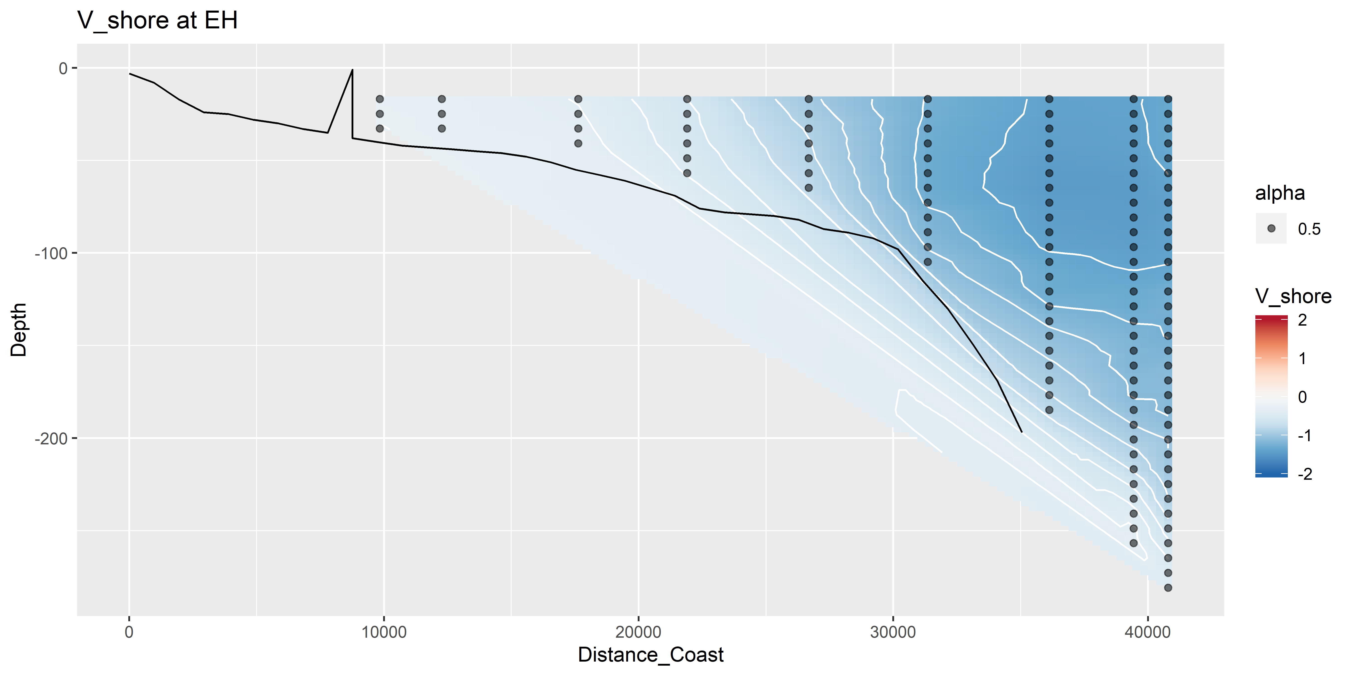
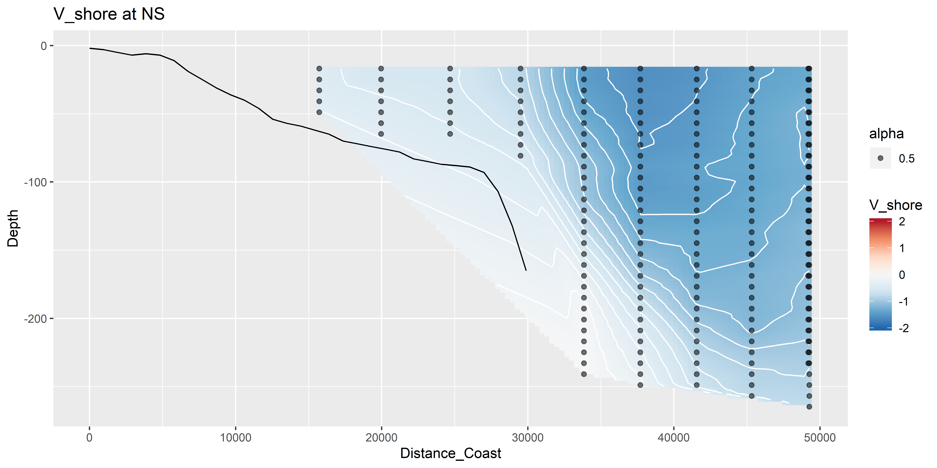
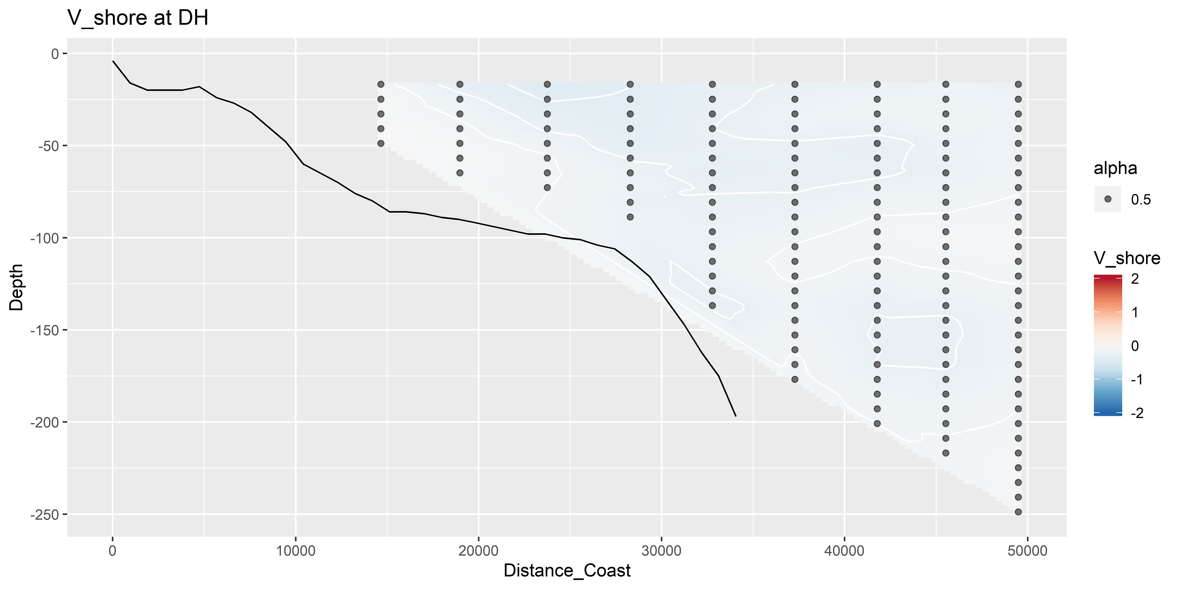
V vectors – shoreline rotated (m s⁻¹)

Slide 14
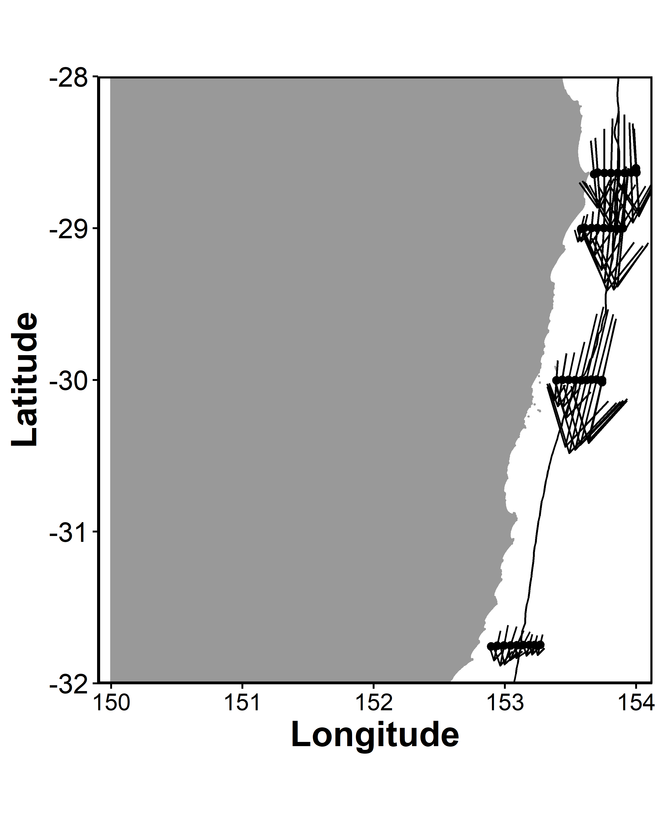
ADCP Velocity on a map

Slide 15
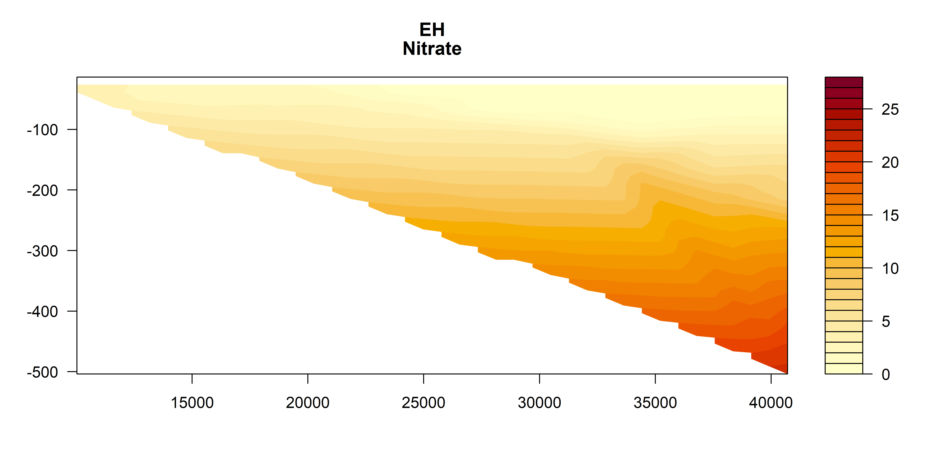
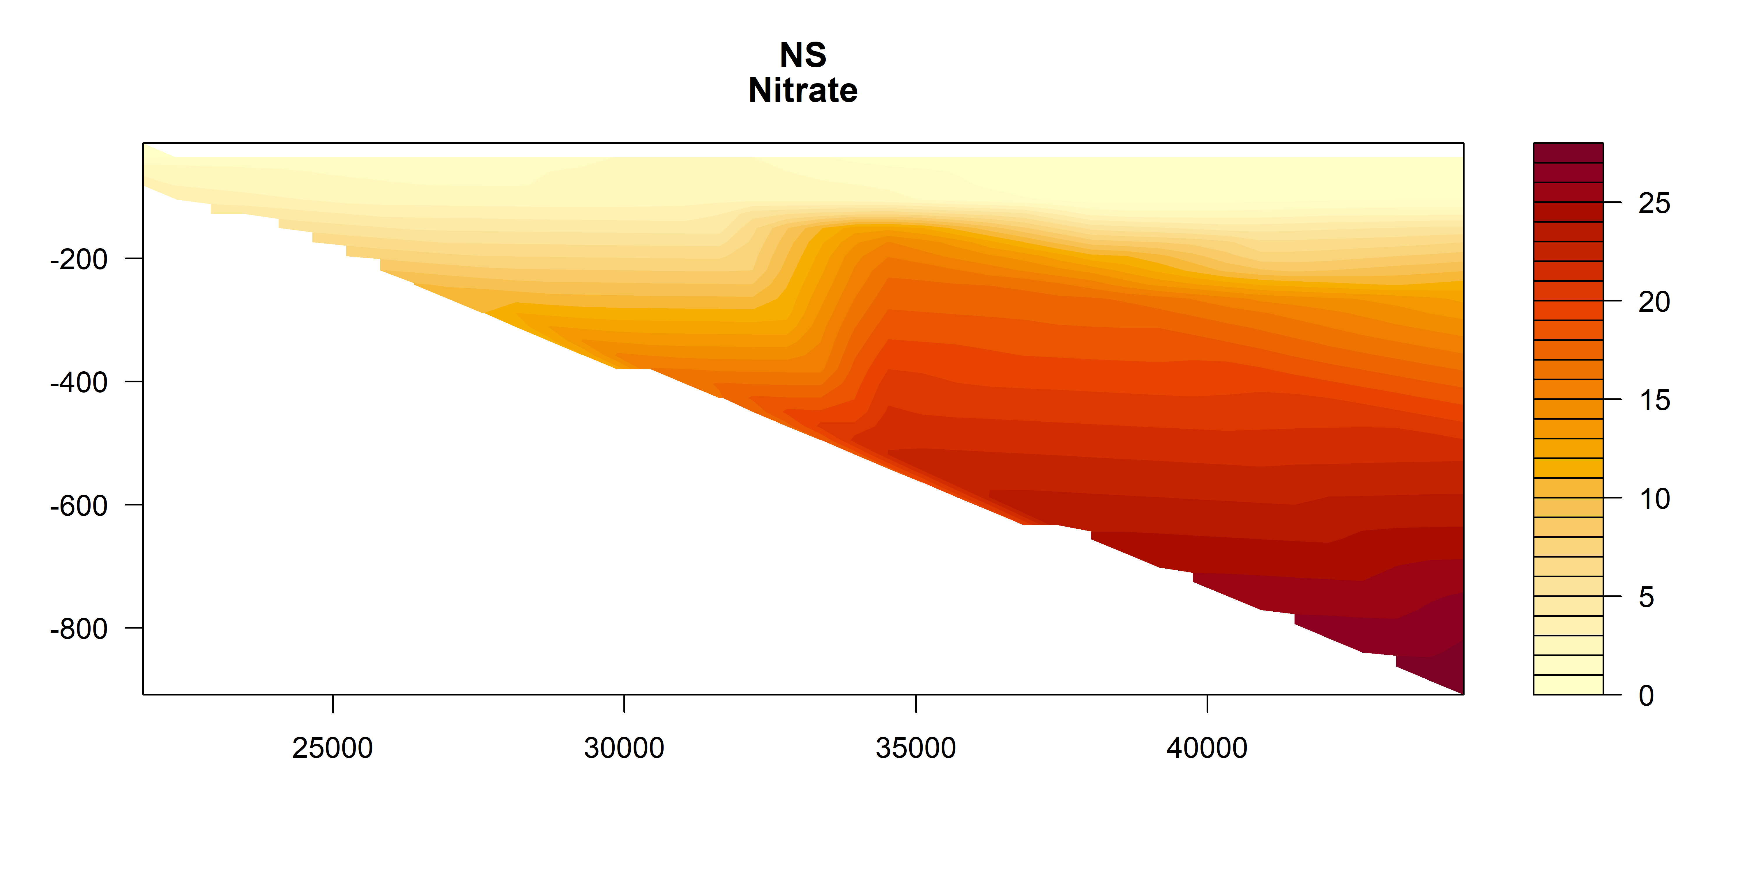
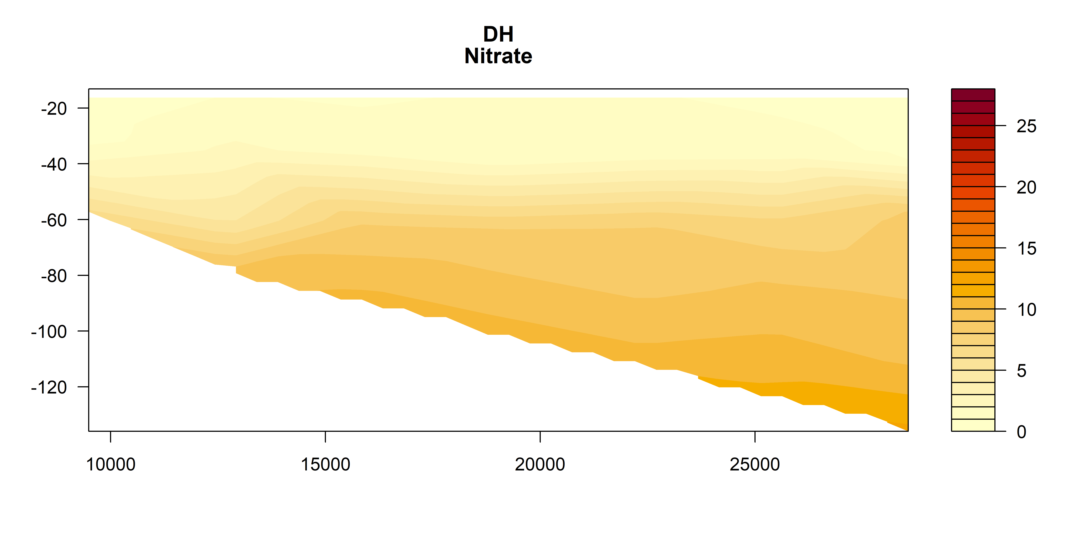
Nitrate

Slide 16
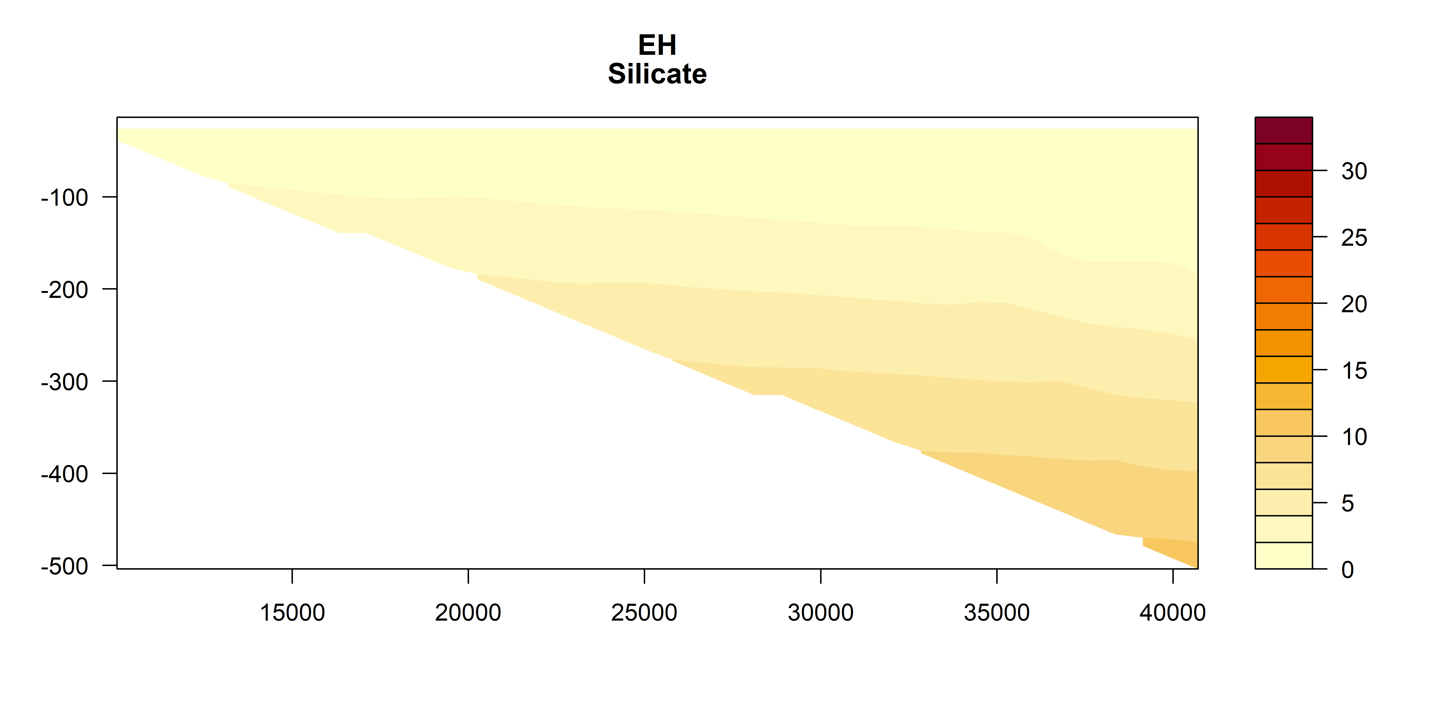
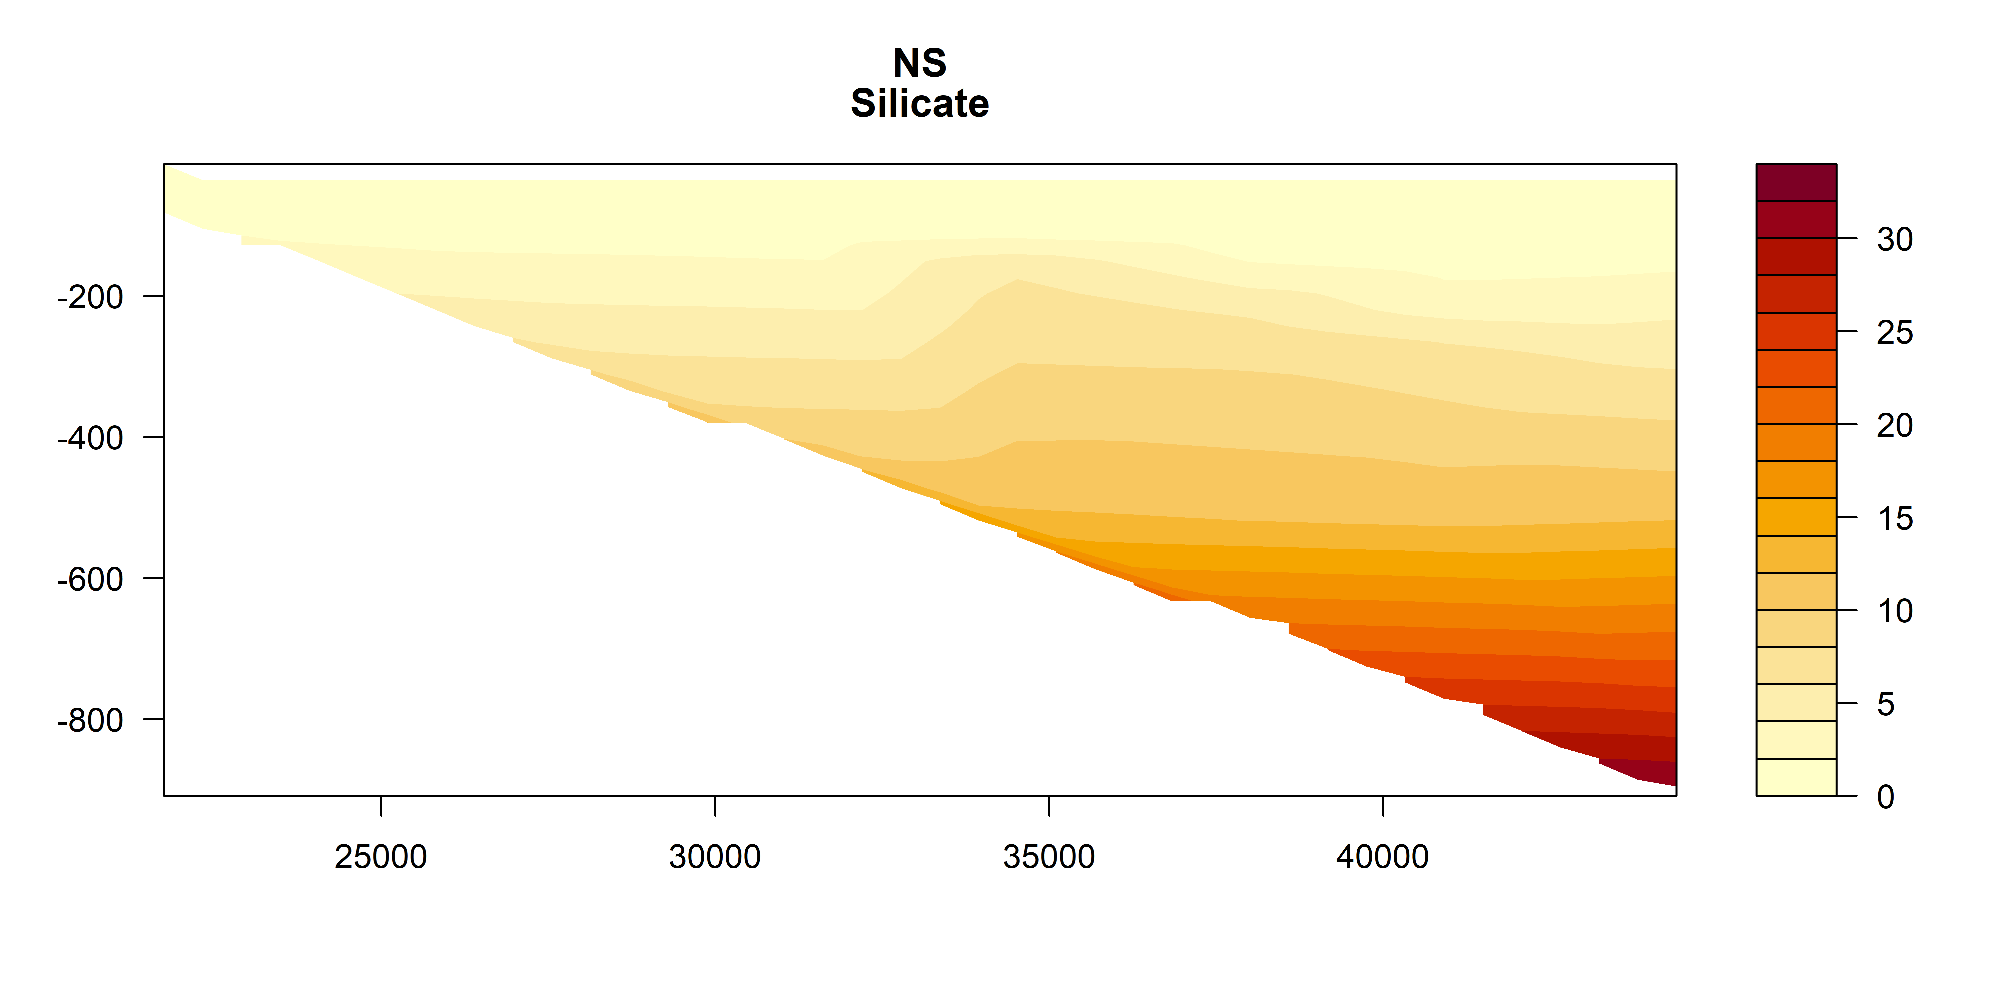
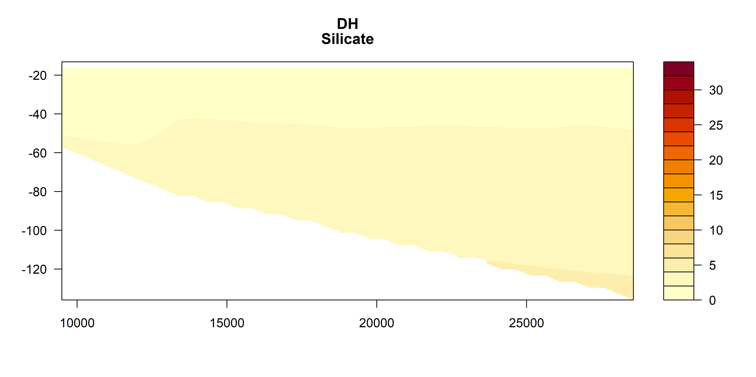
Silicate

Slide 17
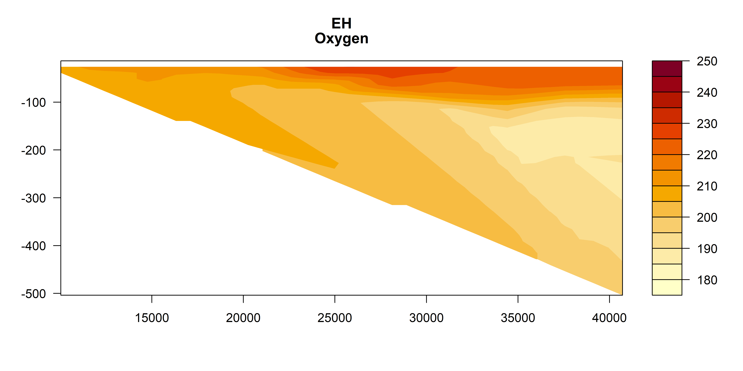
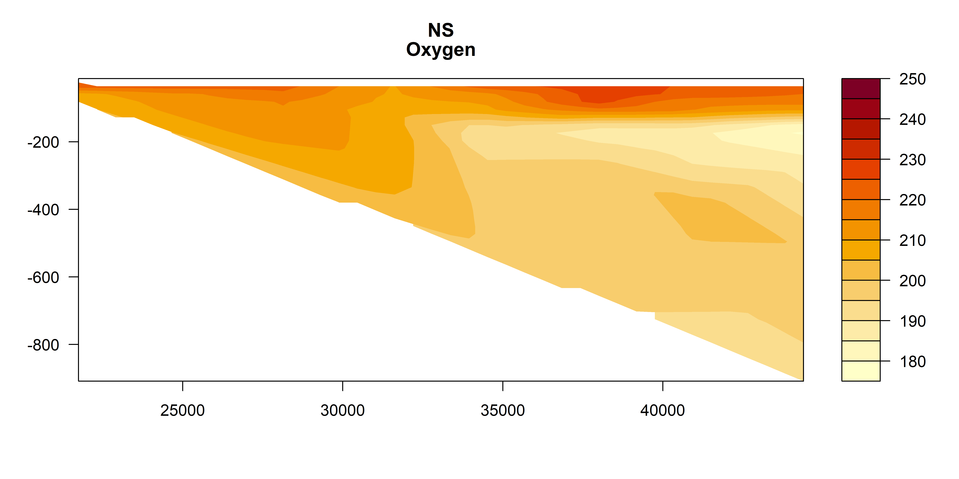
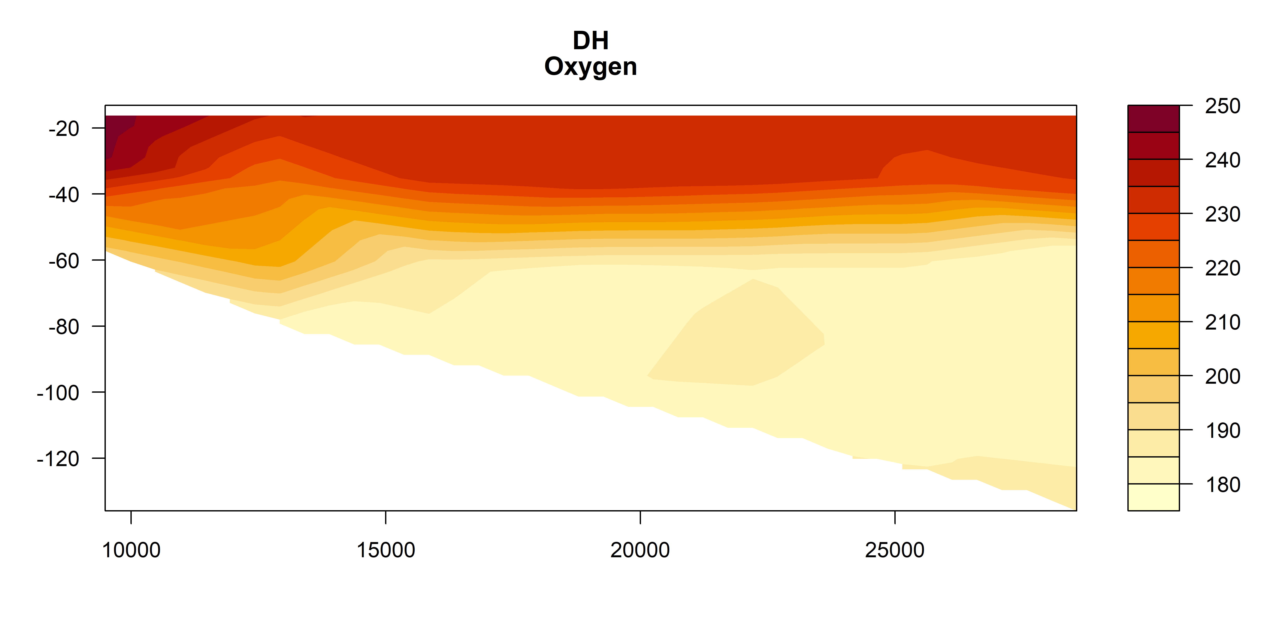
Oxygen

Slide 18
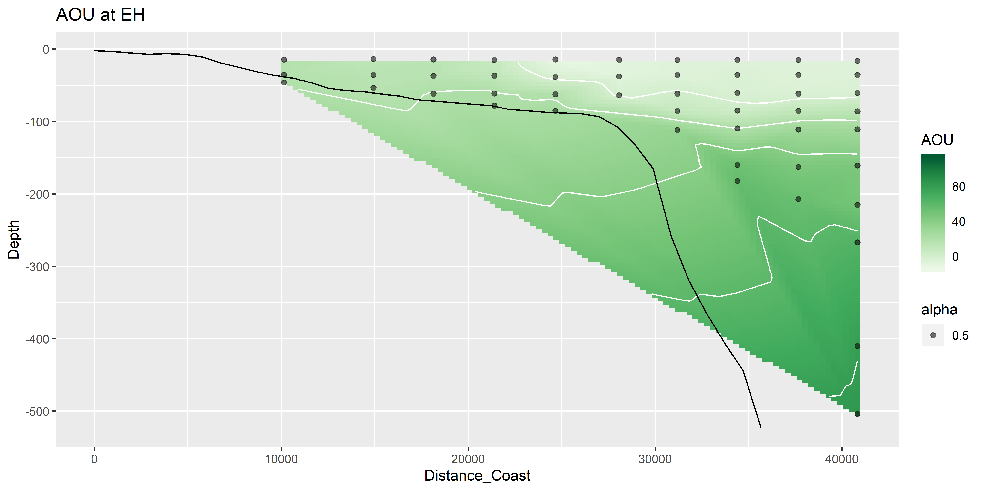
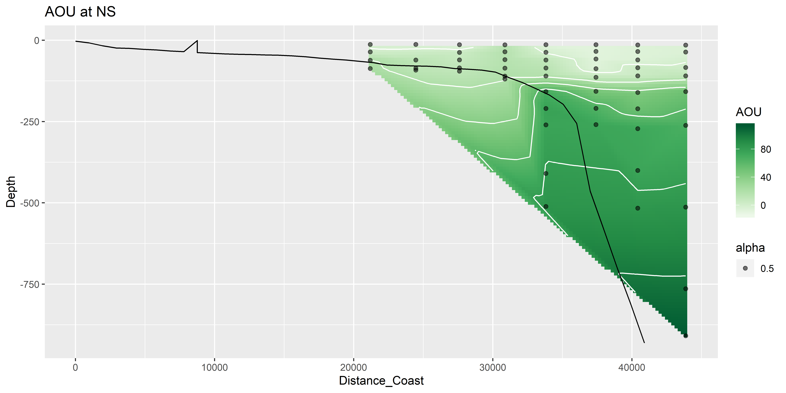
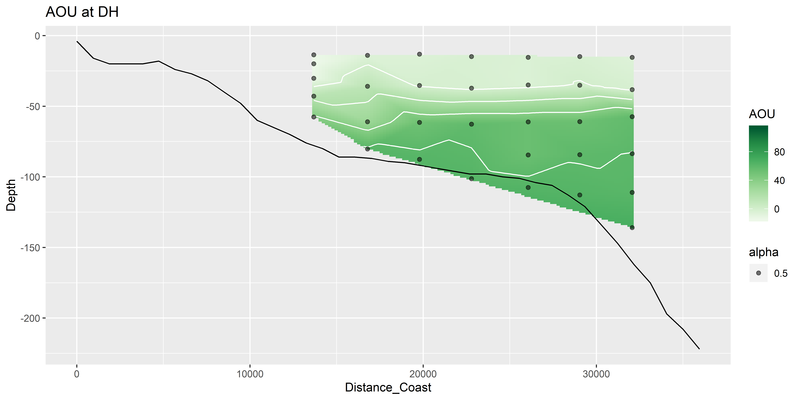
Oxygen utilisation (expected – observed)
um/kg
Positive = respiration (lower O₂ than expected)
Negative = photosynthesis / production
um/kg
um/kg

Slide 19
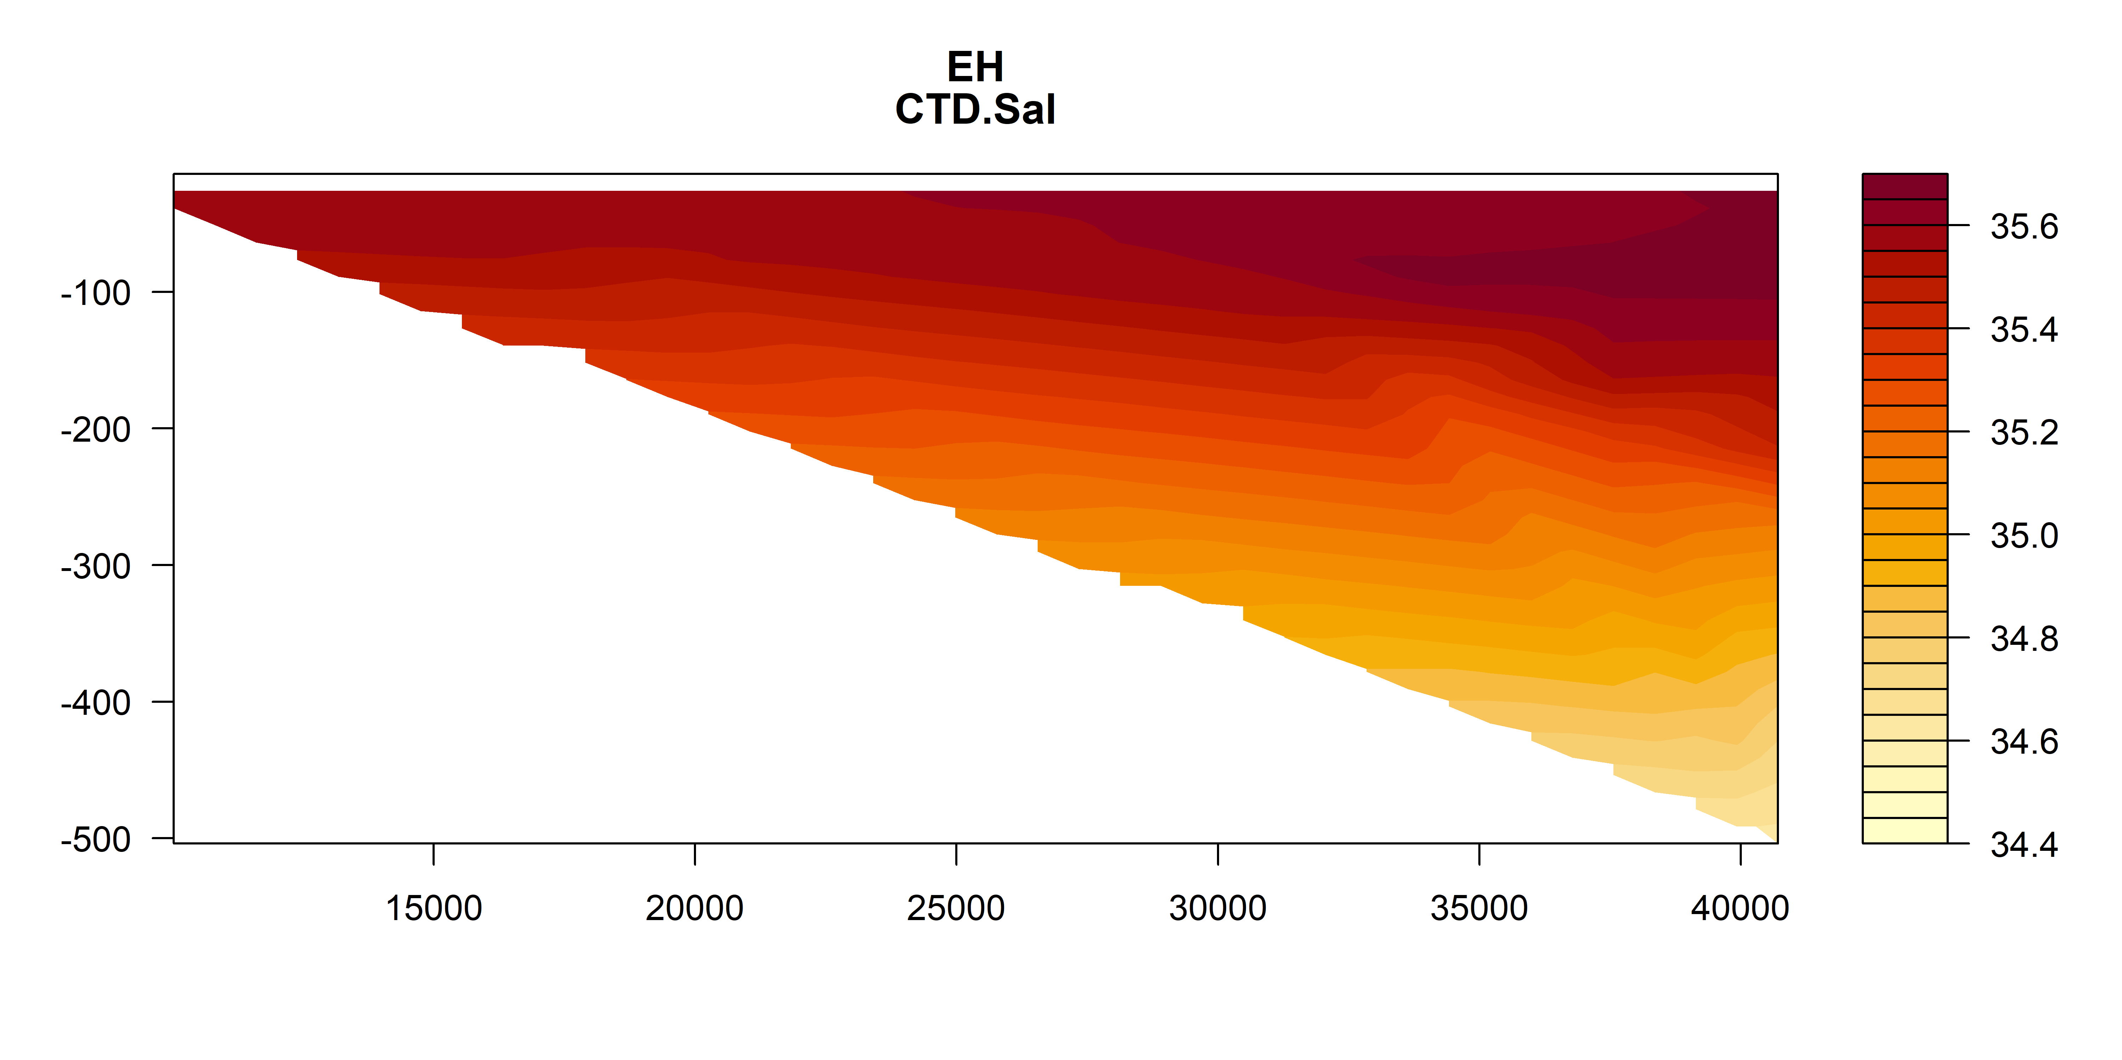
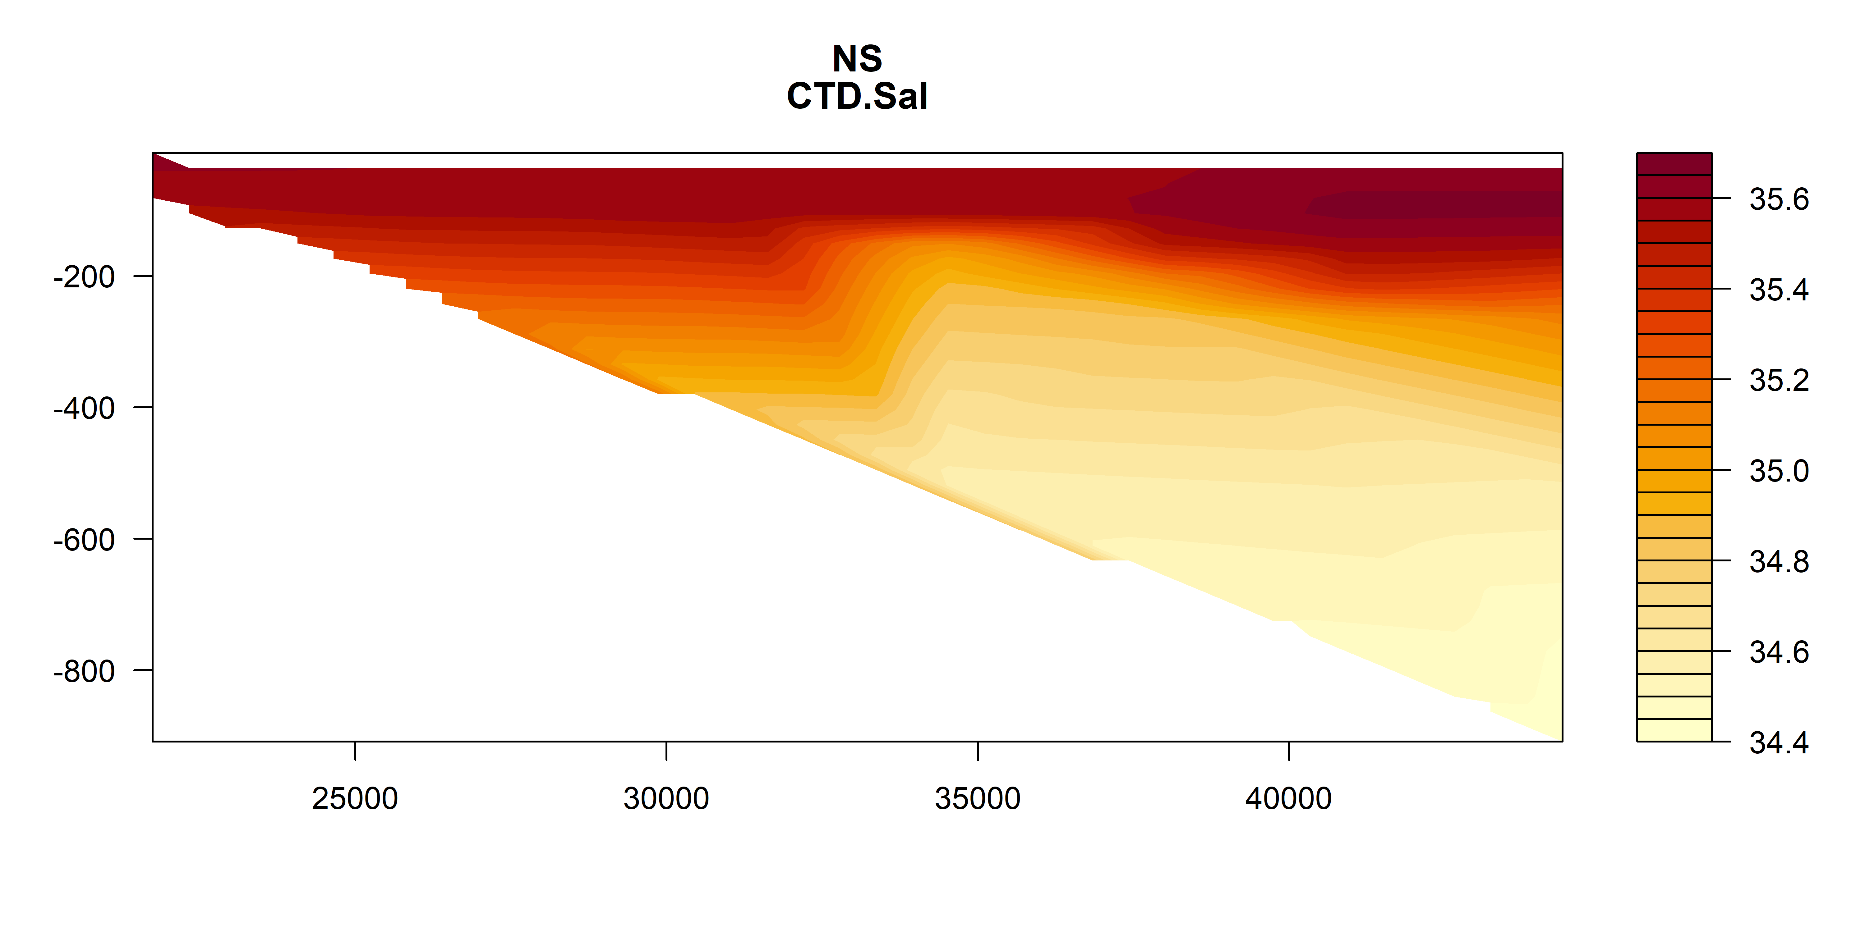
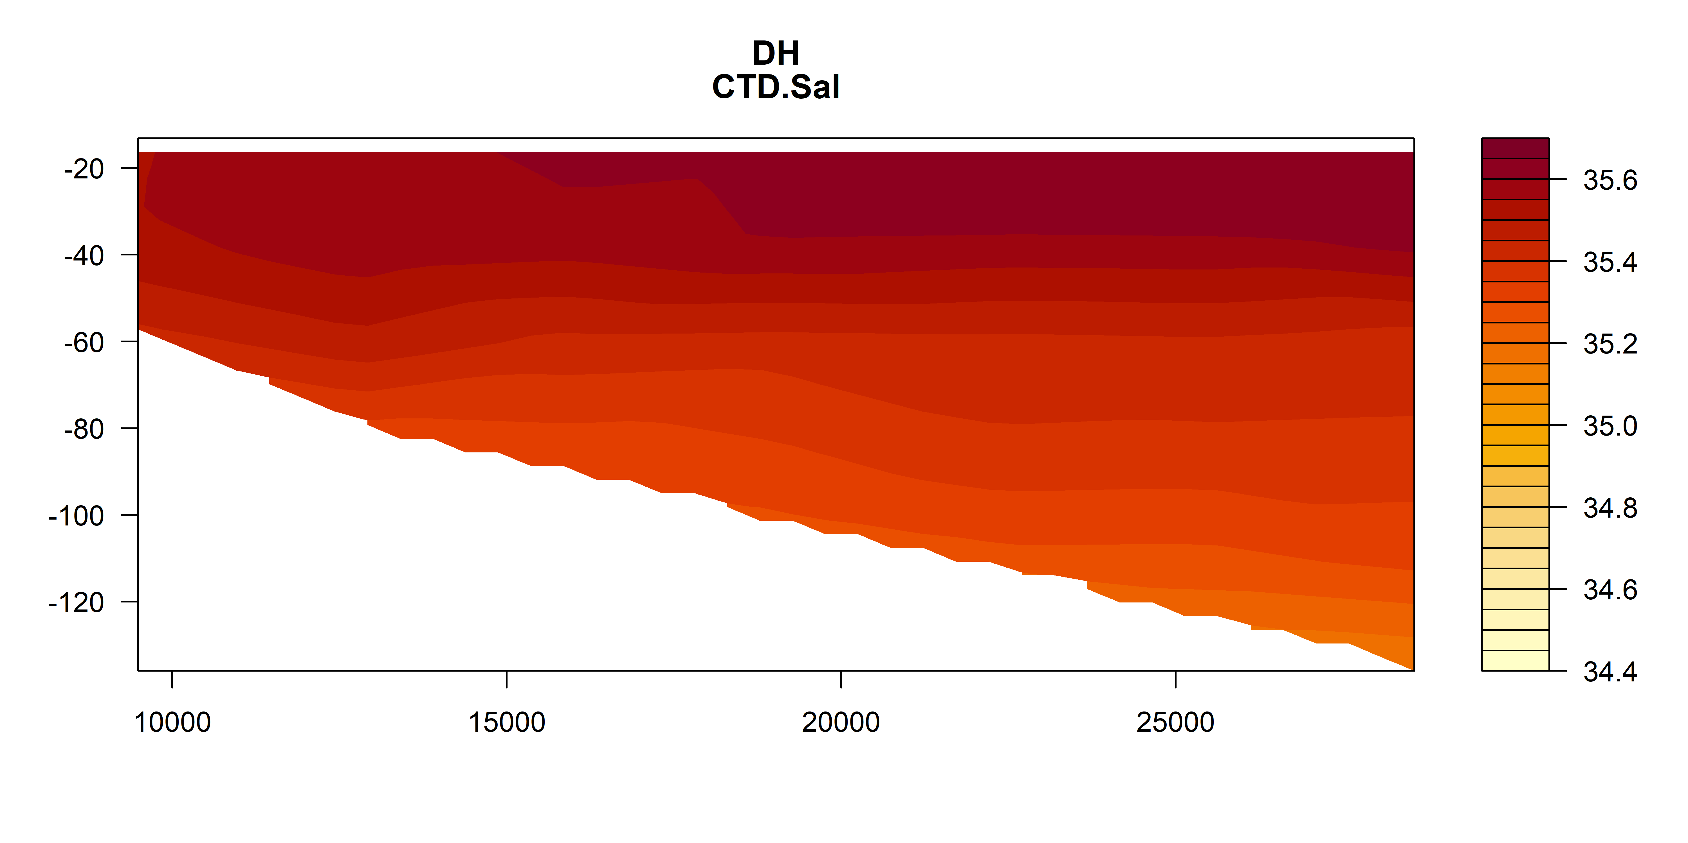
Salinity

Slide 20
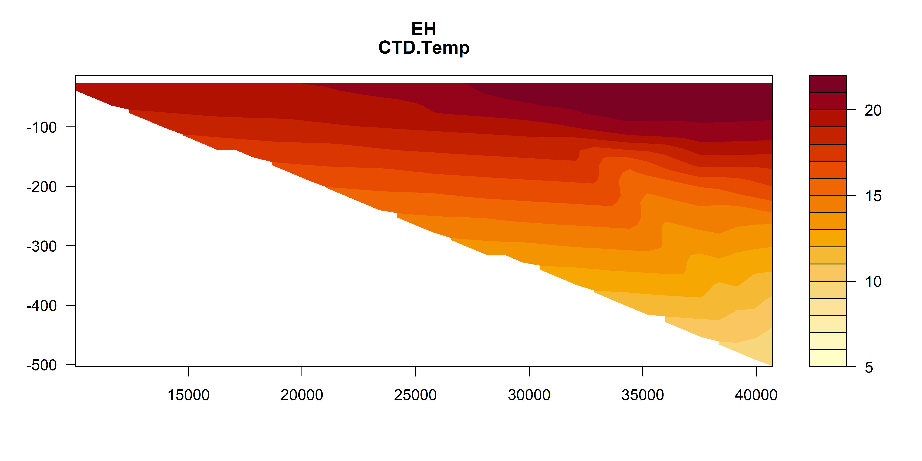
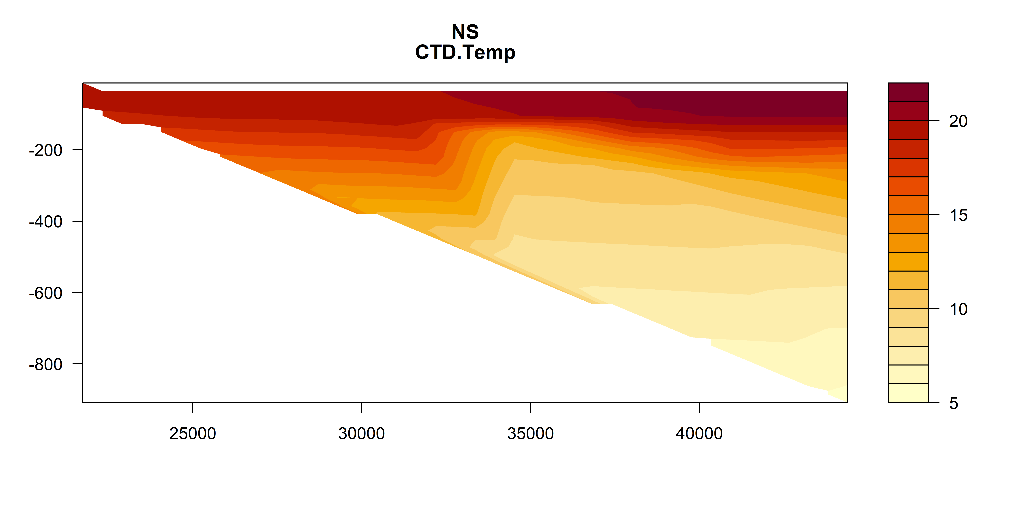
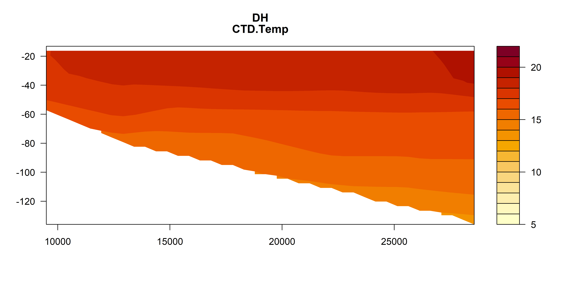
Temperature
Deg C
Deg C
Deg C

Slide 21
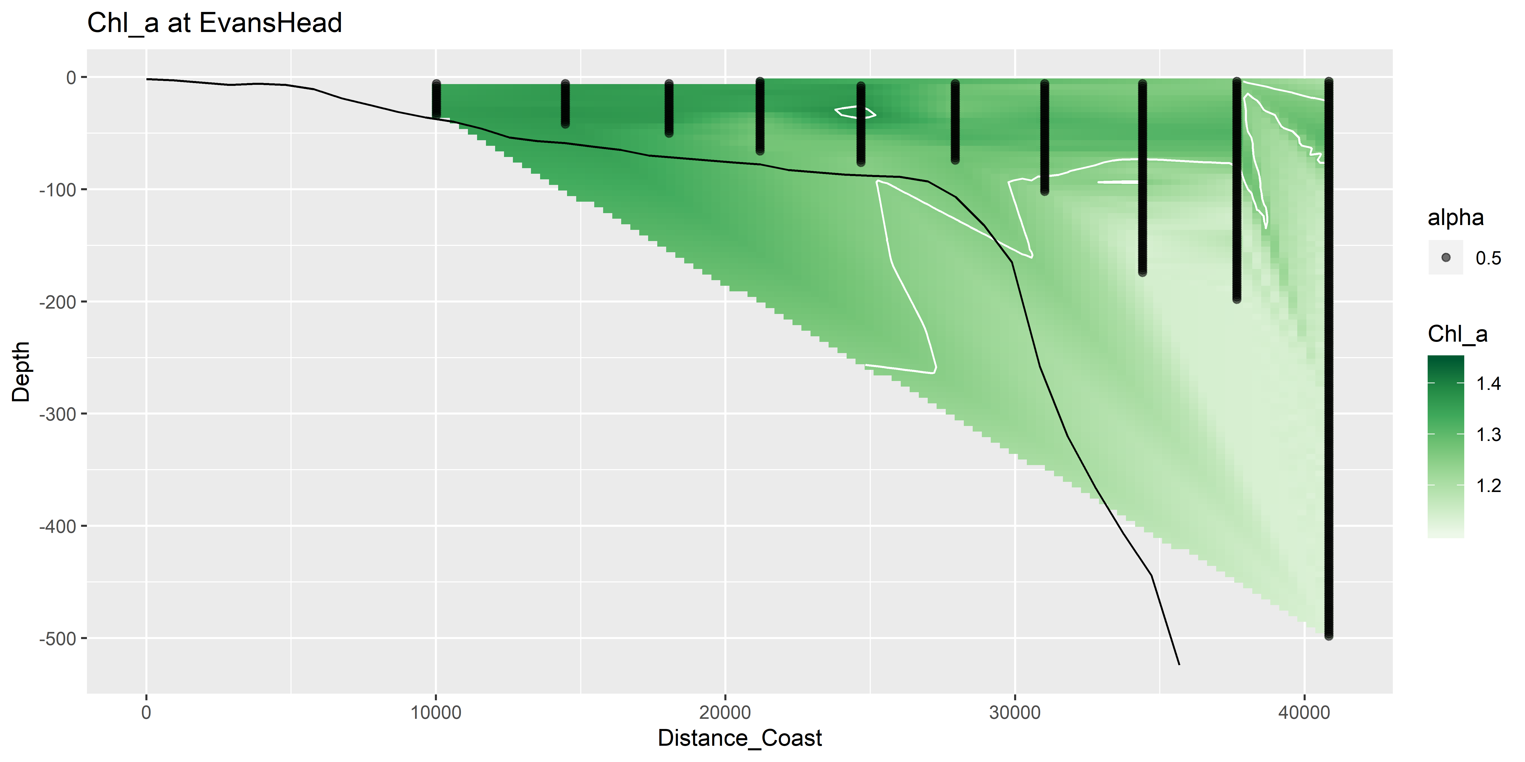
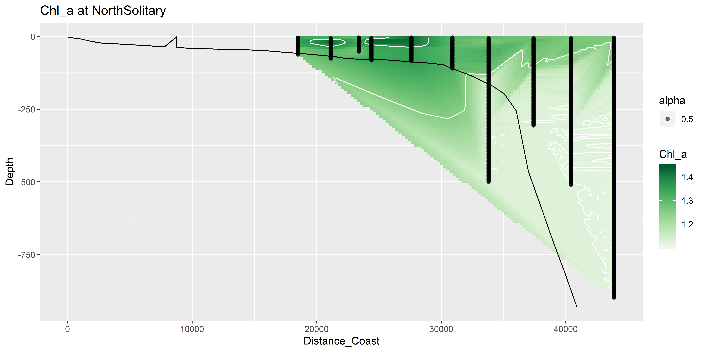
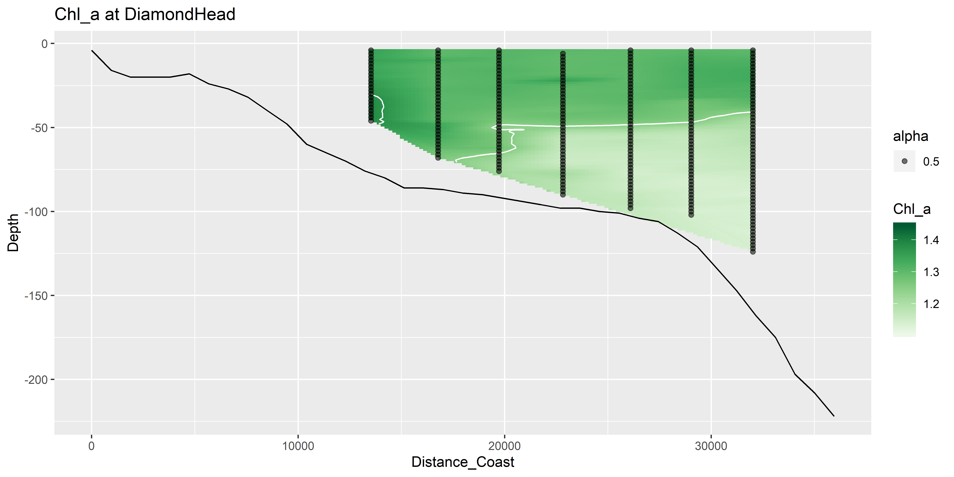
Chl_a

Slide 22
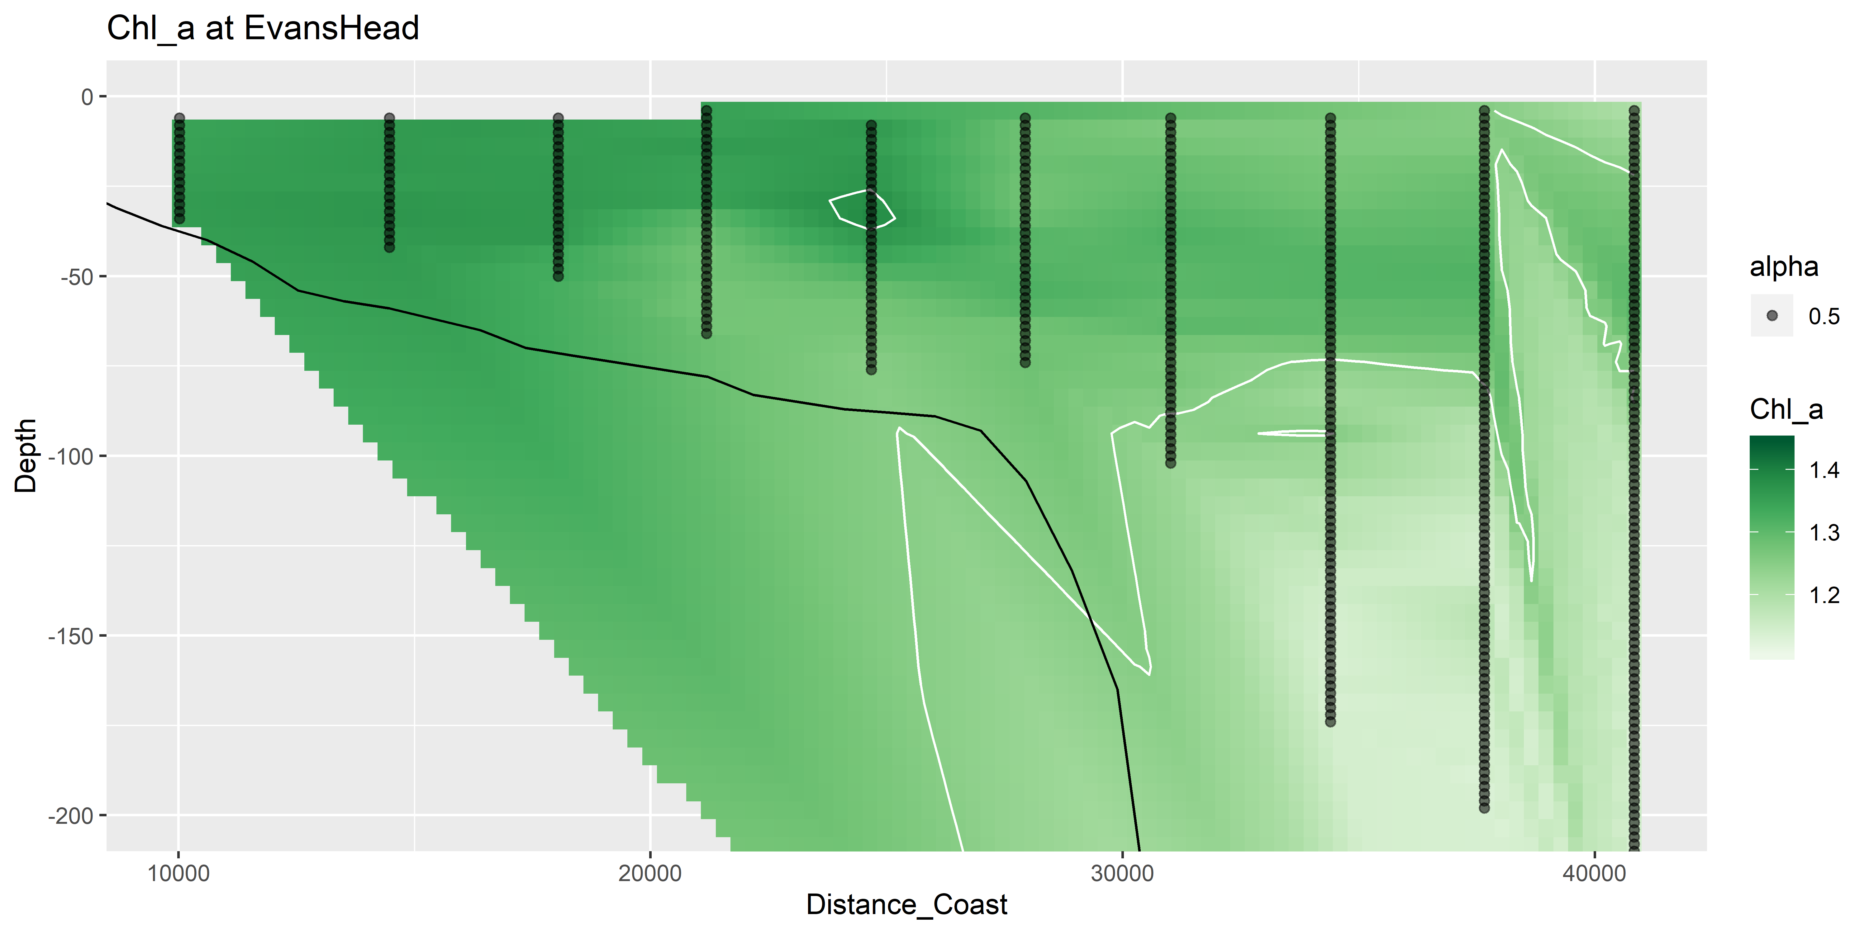
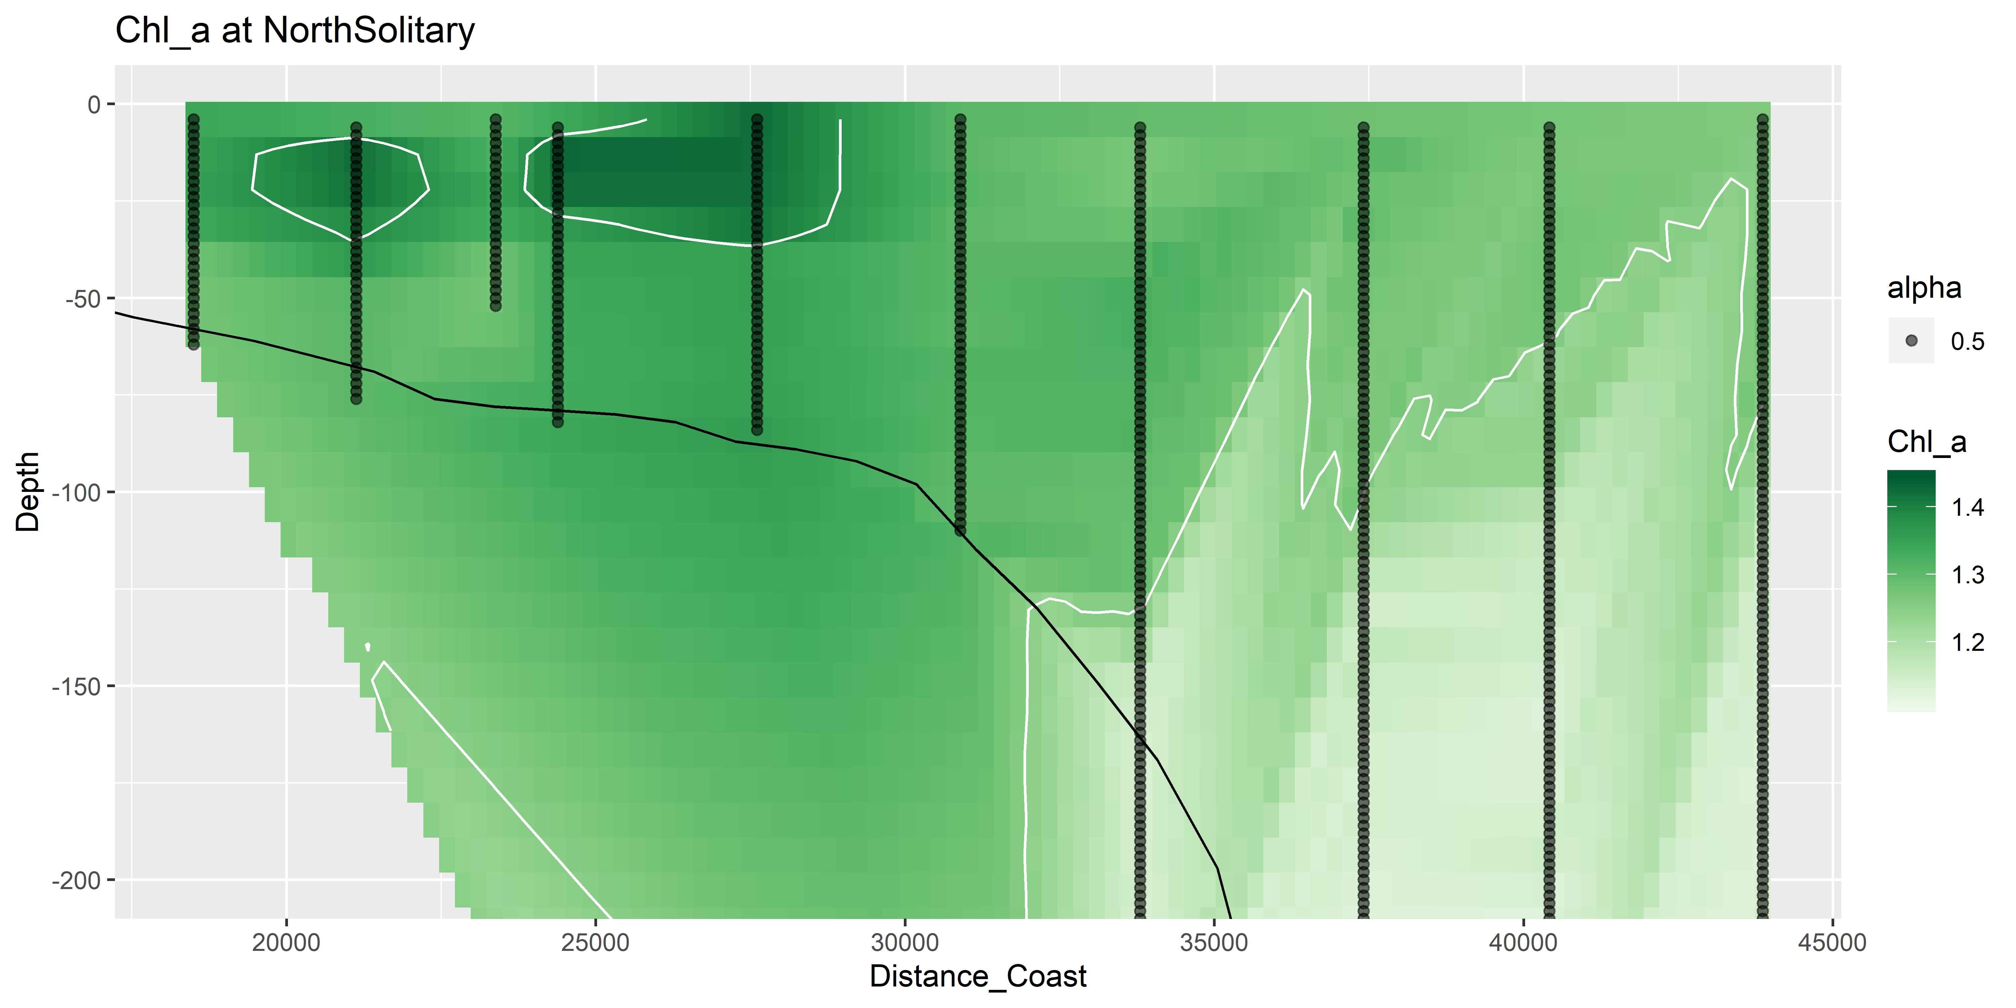
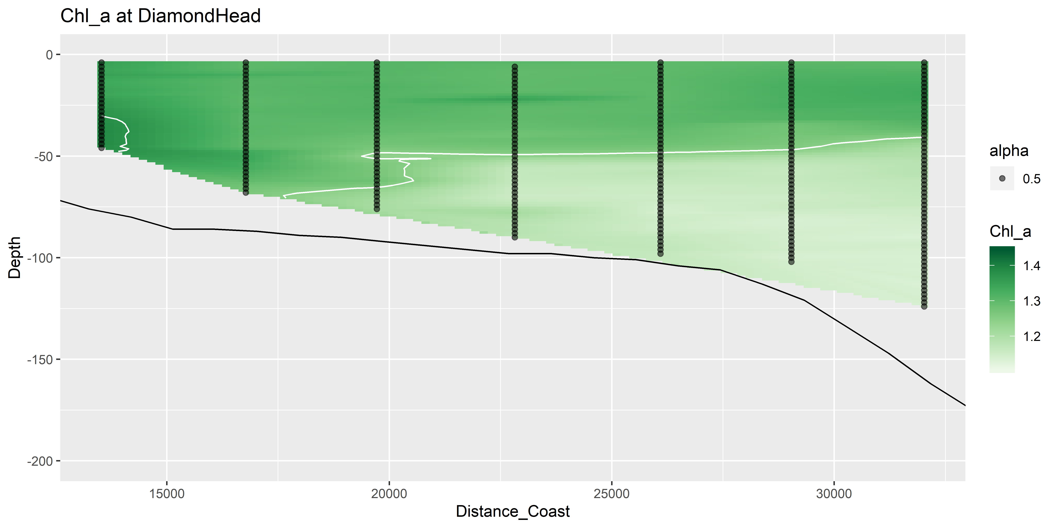
Chl_a top 200m

Slide 23
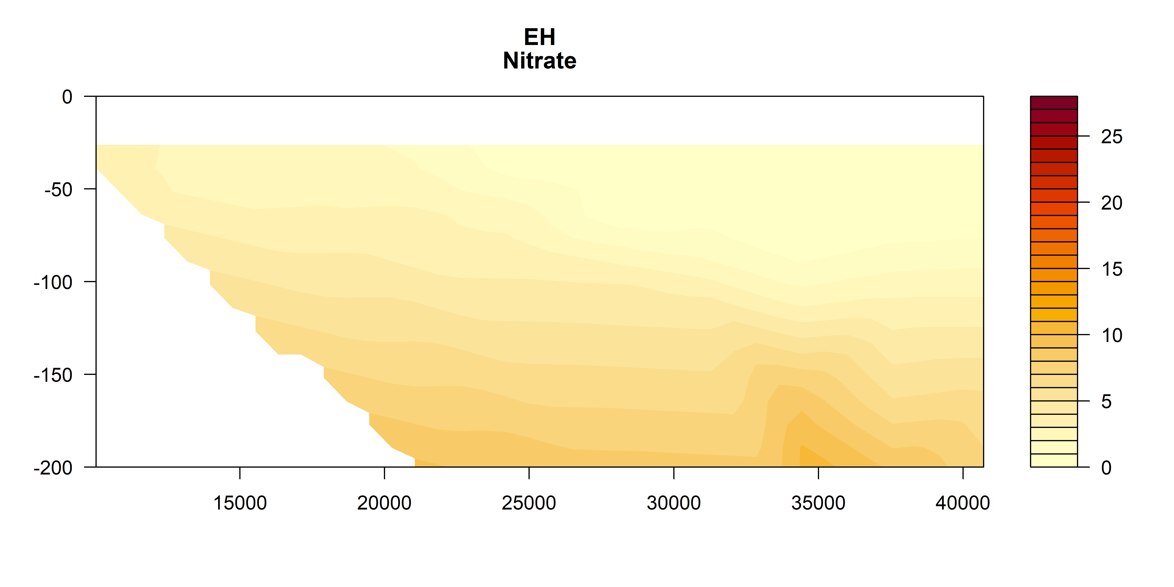


Nitrate

Slide 24



Silicate

Slide 25



Oxygen

Slide 26



Oxygen utilisation (top 200m)
um/kg
Positive = respiration (lower O₂)
Negative = photosynthesis / production
um/kg
um/kg

Slide 27



Salinity

Slide 28



Temperature

Slide 29

Zooplankton Biomass temperature contours

Slide 30




Zooplankton Biomass

Slide 31




NBSS Slope

Slide 32




Pareto Slope

Slide 33

Abundance

Slide 34




Abundance

Slide 35




Geometric Mean Size

Slide 36

Wind Stress

Slide 37

Modelling Zooplankton Biomass
Call: lm(formula = Biomass ~ Temp + Salt + Depth + site + Distance_Coast, data = mydata)
All variables significant except Salinity (P = 0.25)
Adj R² = 0.58
No autocorrelation taken in account ☹

Slide 38

Modelling Pareto Slope
Call: lm(formula = ParetoSlope ~ Temp + Salt + Depth + site + Distance_Coast, data = mydata)
All variables significant except Depth (P = 0.25)
Adj R² = 0.33
No autocorrelation taken in account ☹

Slide 39
Expectations
Areas of upwelling should have higher nutrients and plankton abundance
Areas offshore (open ocean water) should have slopes closer to -1
Southern sites should have higher biomass (colder water influence)

Slide 40
Patterns
Inshore North Solitary shows some upwelling + higher nutrients + biomass
North Solitary, Evans Head and Cape Byron have high surface biomass offshore (but not abundance?) – this is weird Data error
Abundance (and biomass) increases towards the shelf (I think this is common but relatively unpublished?)

